Slide 1
Lynwood series W76 E50 & E70

Slide 2
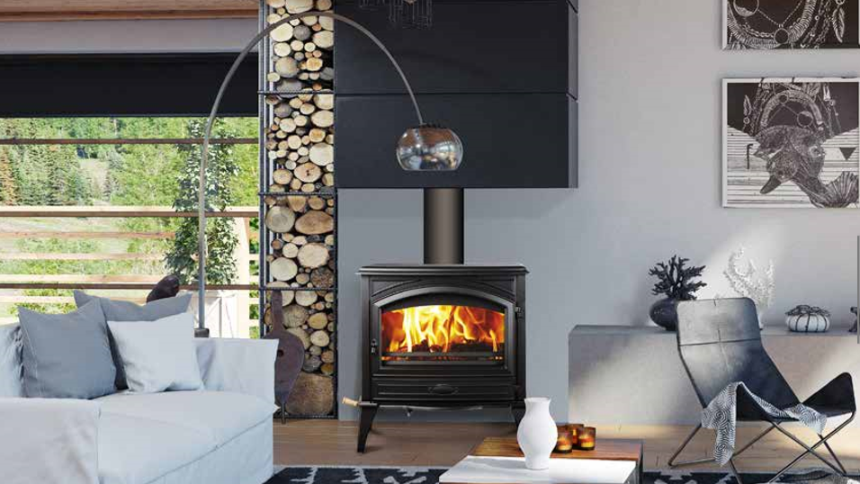
Lynwood – W76 WoOd stove
Sierra Flame is happy to introduce Lynwood W76, our EPA 2020 compliant high efficiency wood stove

Slide 3
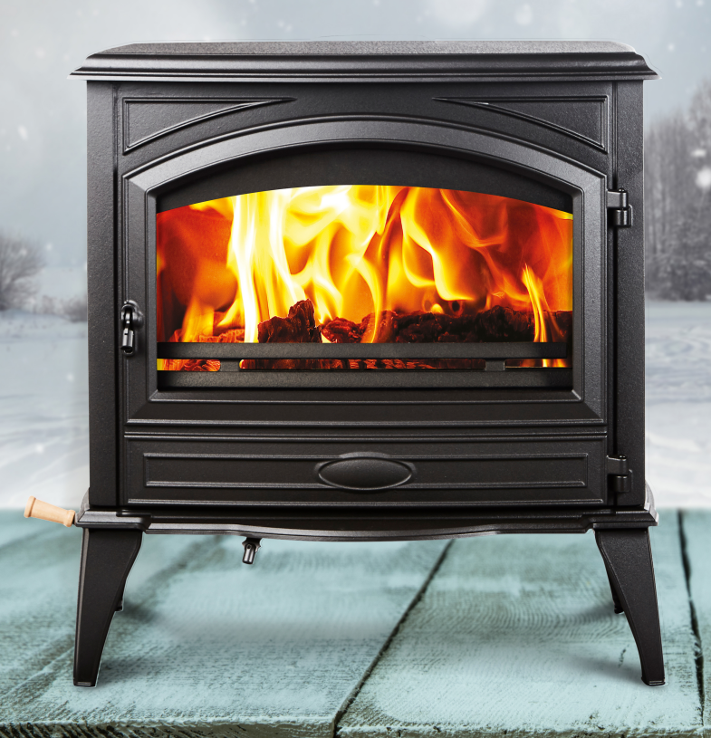
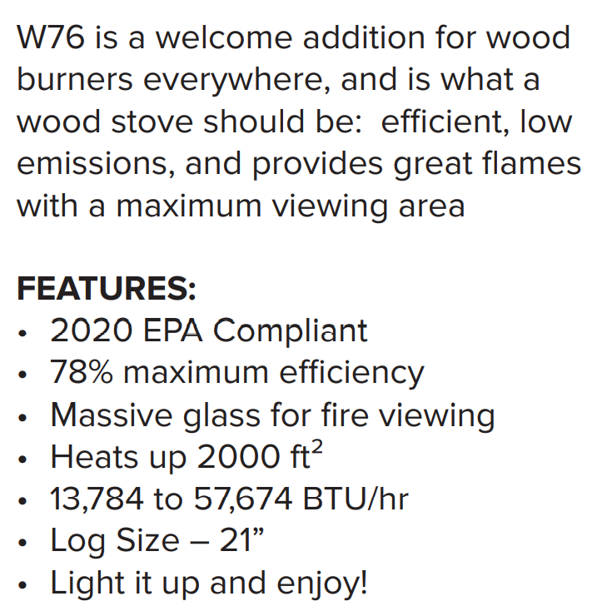

Slide 5
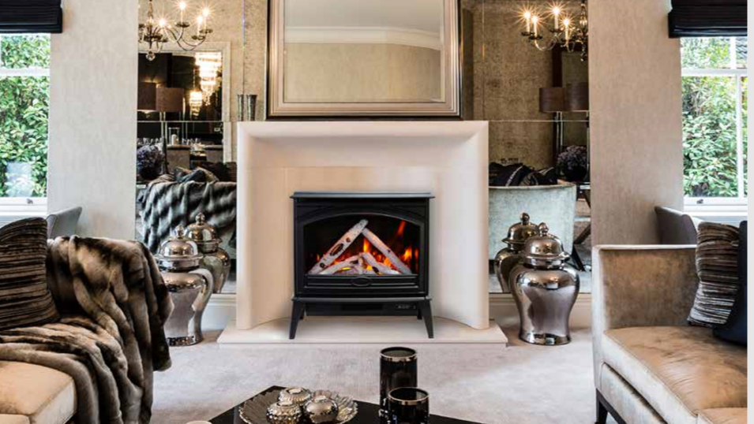
LYNWOOD
ELECTRIC
Real Cast Iron Construction
50” & 70” ( E50 & E70)
Rated for Indoor Applications only
Lower heat vent, allows the heat to flow directly to floor level
Two Flame Sets and canopy lighting in 13 color themes, creates the illusion of a real fire
Produces up to 4800 BTU of heat, enough to heat up to 500 sq. ft
Includes a multi function remote & 10 pce birch media kit

Slide 6
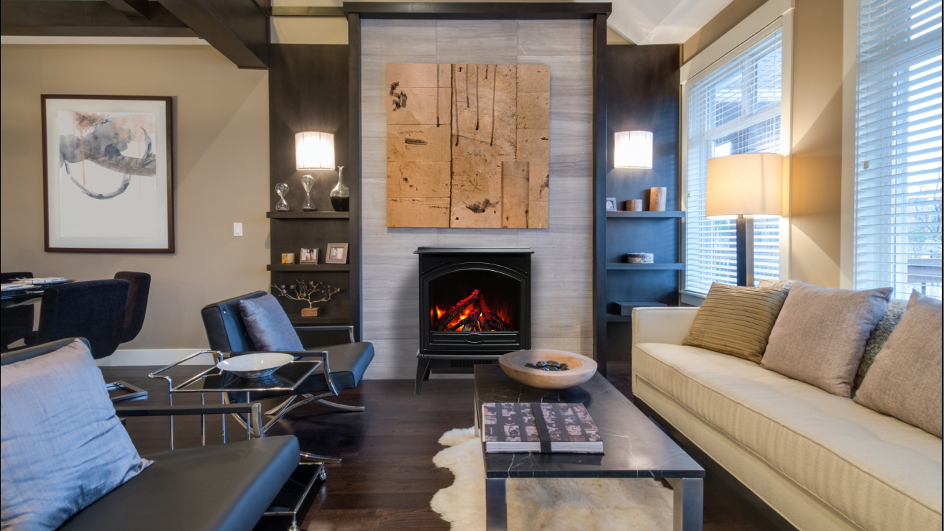

Slide 7
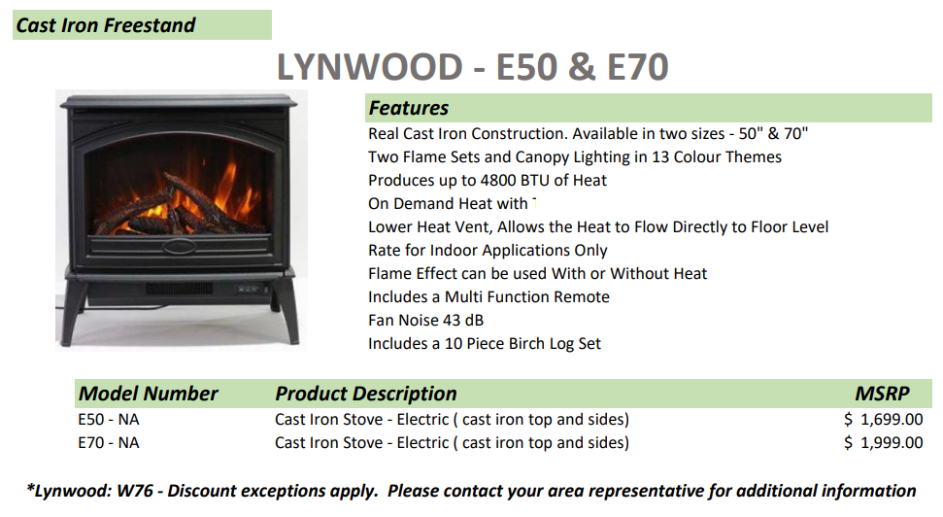

Slide 8
