Slide 1
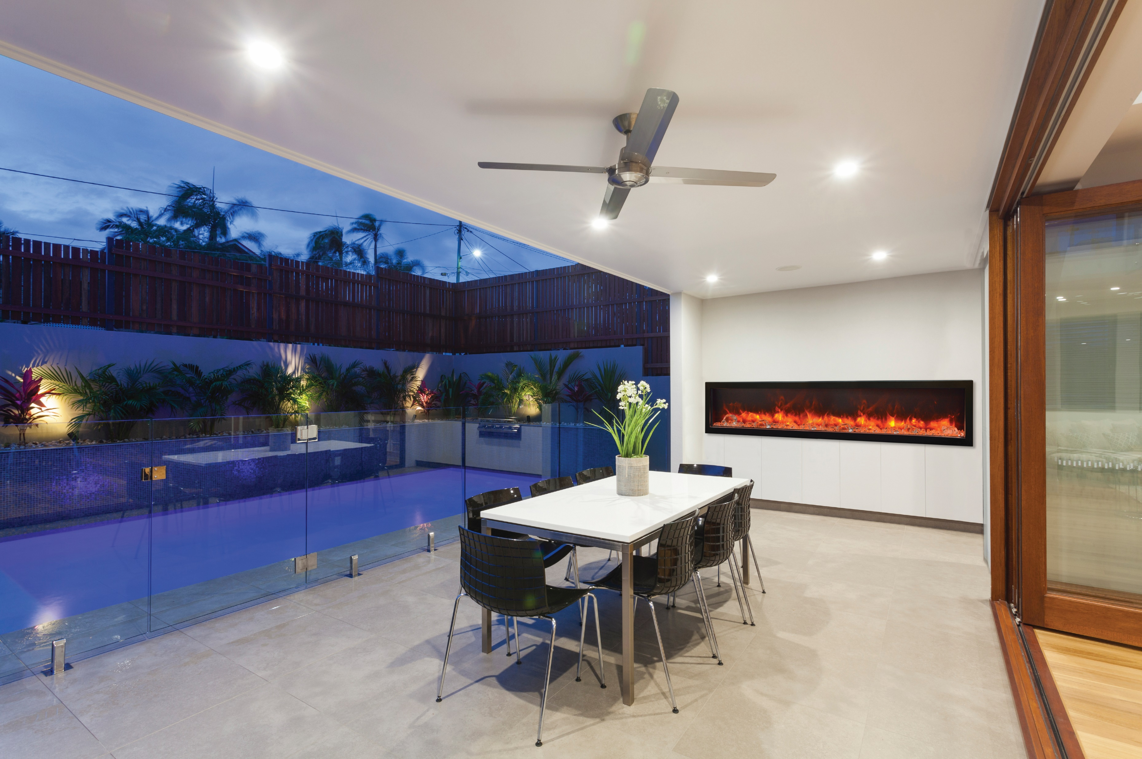

Slide 2
AMANTII Electric Fireplaces
Designer Media Kits
Traditional Series
Tru View Series
Symmetry Series

Slide 3
Designer Media kits
Design Media -6 pce
Design Media – Rustic -14 pce
Design Media – Drift -15 pce
Design Media- Birch – 15 pce
NEW! Design Media Birch 10 pce
NEW! Design Media Oak 10 pce

Slide 4
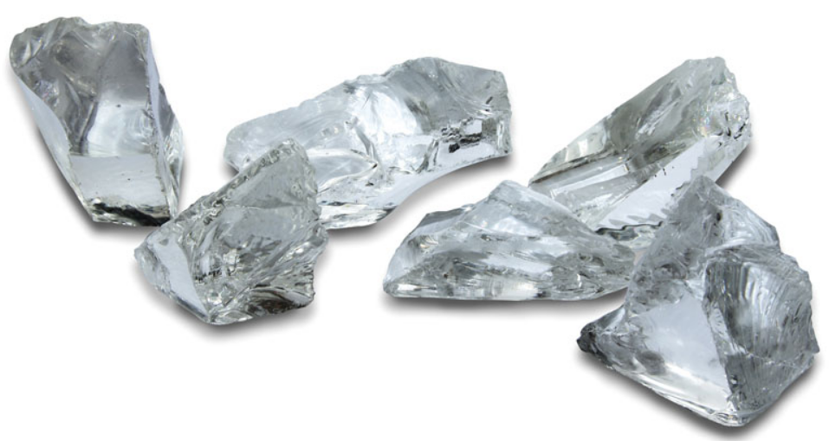
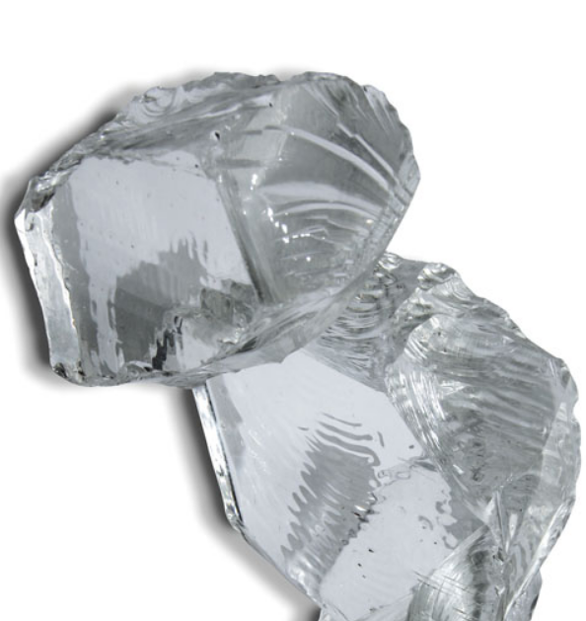
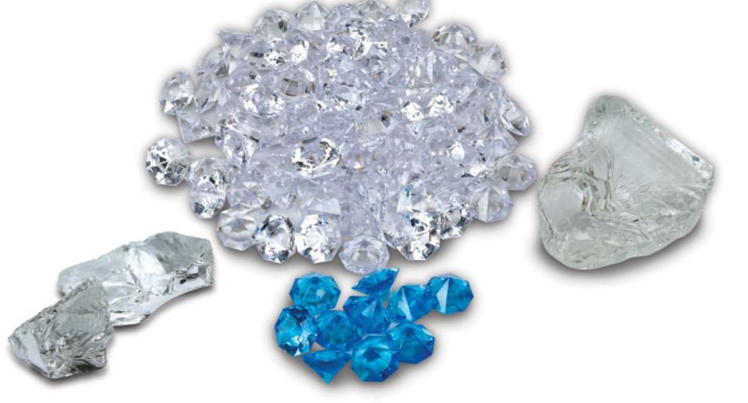
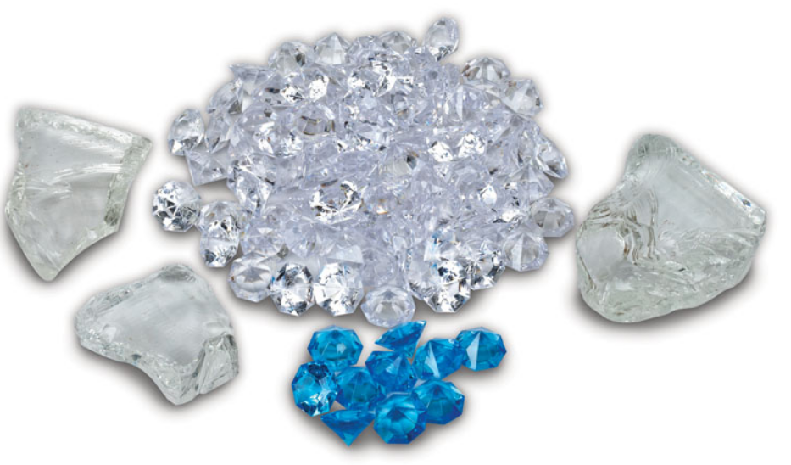

Slide 5
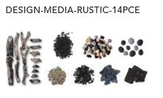
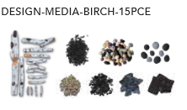
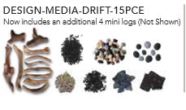
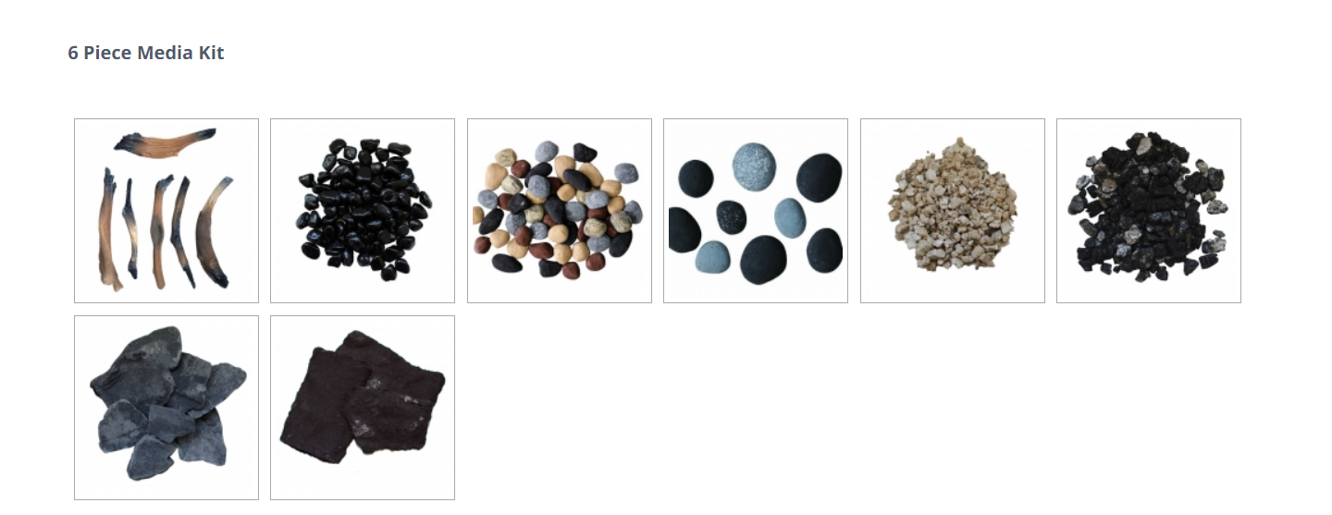

Slide 6
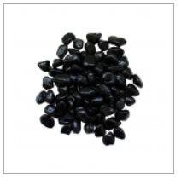
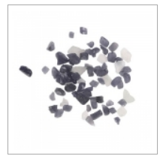
AMSF-GLASS-02 $55.00
AMSF-GLASS-05 $55.00
AMSF-GLASS-03 $55.00
AMSF-GLASS-04 $55.00
AMSF-GLASS- 08 $55.00
AMSF-GLASS-11 $55.00
AMSF-GLASS-01 $55.00
AMSF-GLASS-07 $55.00
AMSF-GLASS-13 $55.00
AMSF-GLASS- 10 $55.00
AMSF-GLASS-06 $99.00
AMSF-GLASS-09 -$55.00
Our decorative fireglass media is a beautiful addition to your fireplace. Turn your fireplace into an expressive work of art by simply adding our decorative fireglass media. Our fireglass media adds a distinctly modern feel to your fireplace – mix colour and textures for a unique appearance. Our fireglass is tempered and will not melt or degrade, some discoloration is normal on glass. .
AMSF-GLASS- 12 $55.00
AMSF-GLASS-14 $55.00

Slide 7
Traditional series
Sizes available - TRD 26
- TRD 30
- TRD 33
- TRD 38
- TRD 44
- TRD 48

Slide 8
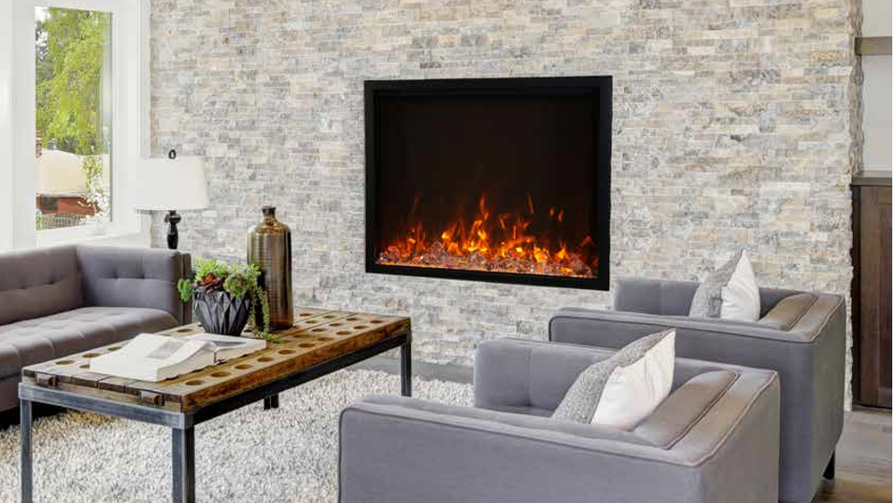
Traditional Series
Approved for Indoor or Outdoor Applications
Series Models: 26”, 30”, 33”, 38”, 44” and 48”
Hidden venting allows for a true clean face appearance
2 Flame Sets. Ambient canopy lighting in 13 colors. Illuminates media like never before
Heater is located in the inner top of the unit, thus allowing the heat to cascade down over the top of the glass
2 Stage Heater. Flame operates with or without heat

Slide 9
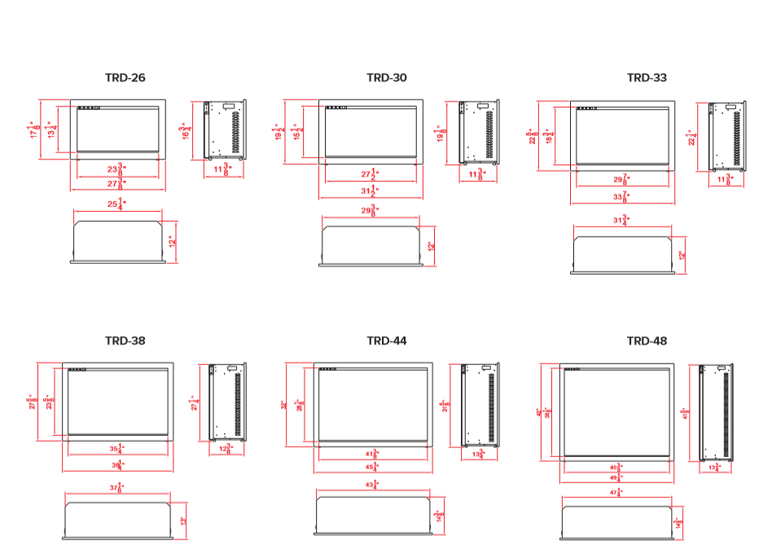

Slide 10
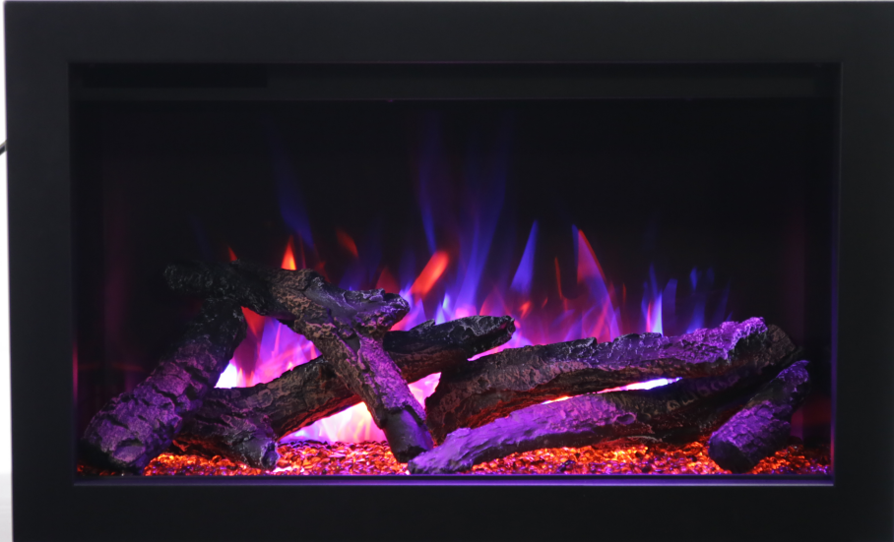

Slide 11
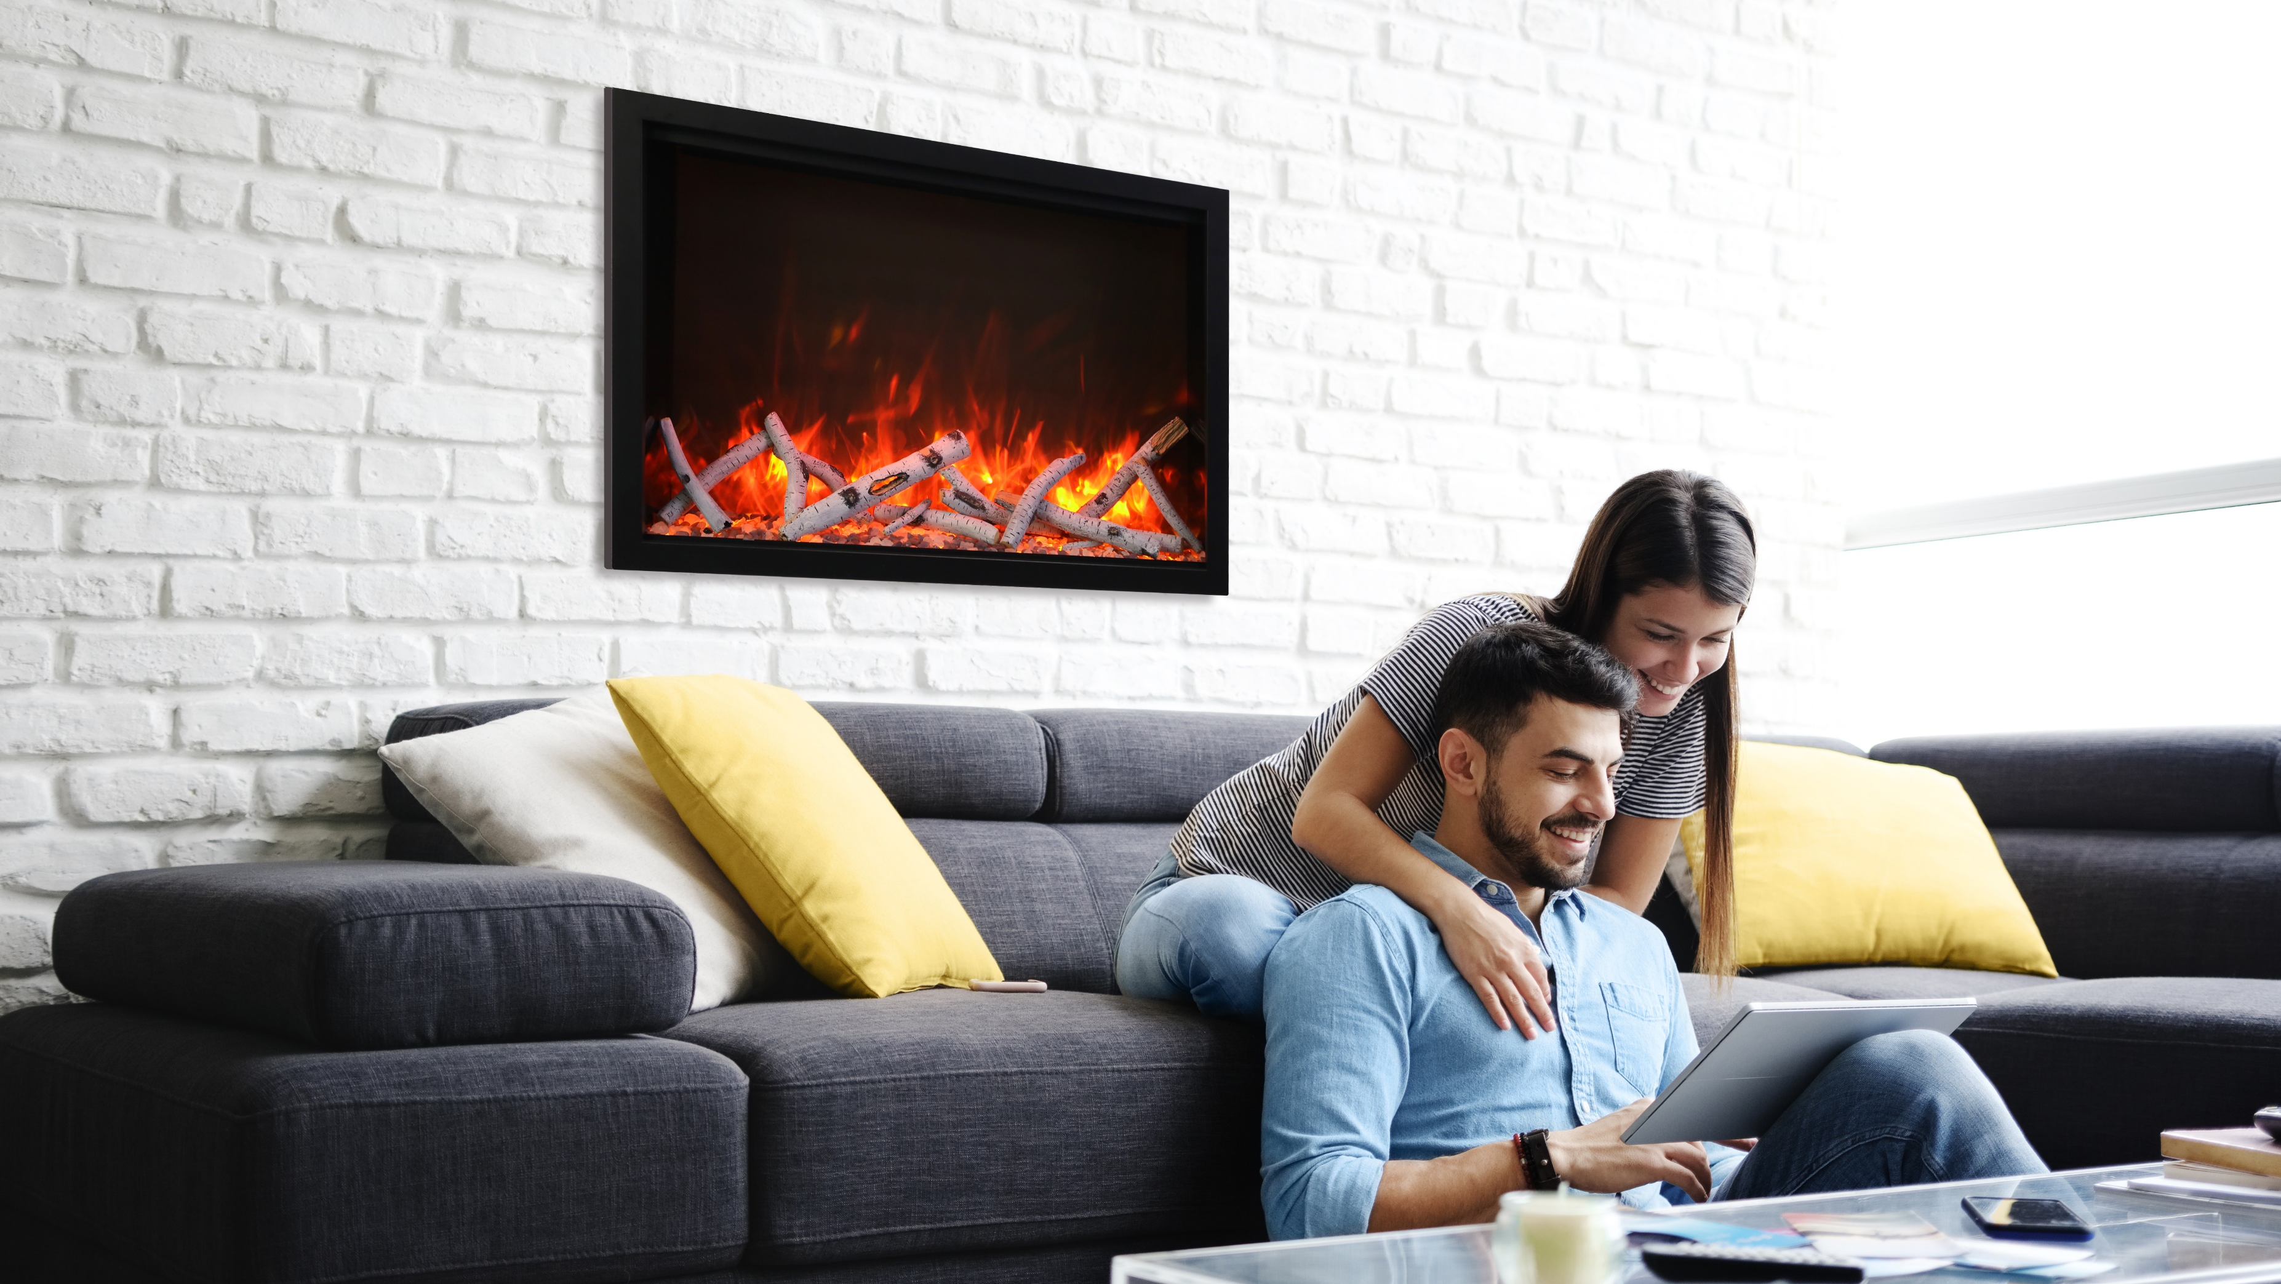

Slide 12
TRaditional Insert Series
Designed as a perfect alternative for wood or gas inserts. Stylish and practical, quick and easy to install
Available in sizes – 26”, 30”, 33” and 38”
Rated for Indoor or Outdoor applications
2 Flame Sets. Ambient canopy lighting in 13 colors. Illuminates media like never before
Heater is located in the inner top of the unit, thus allowing the heat to cascade down over the top of the glass
2 Stage Heater. Flame operates with or without heat

Slide 13
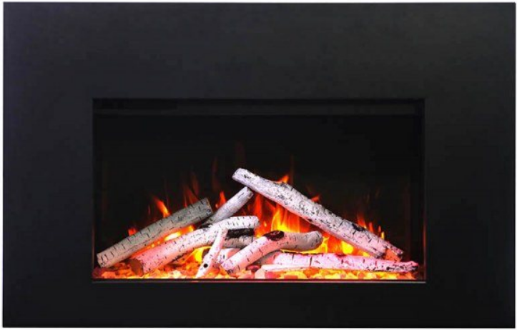
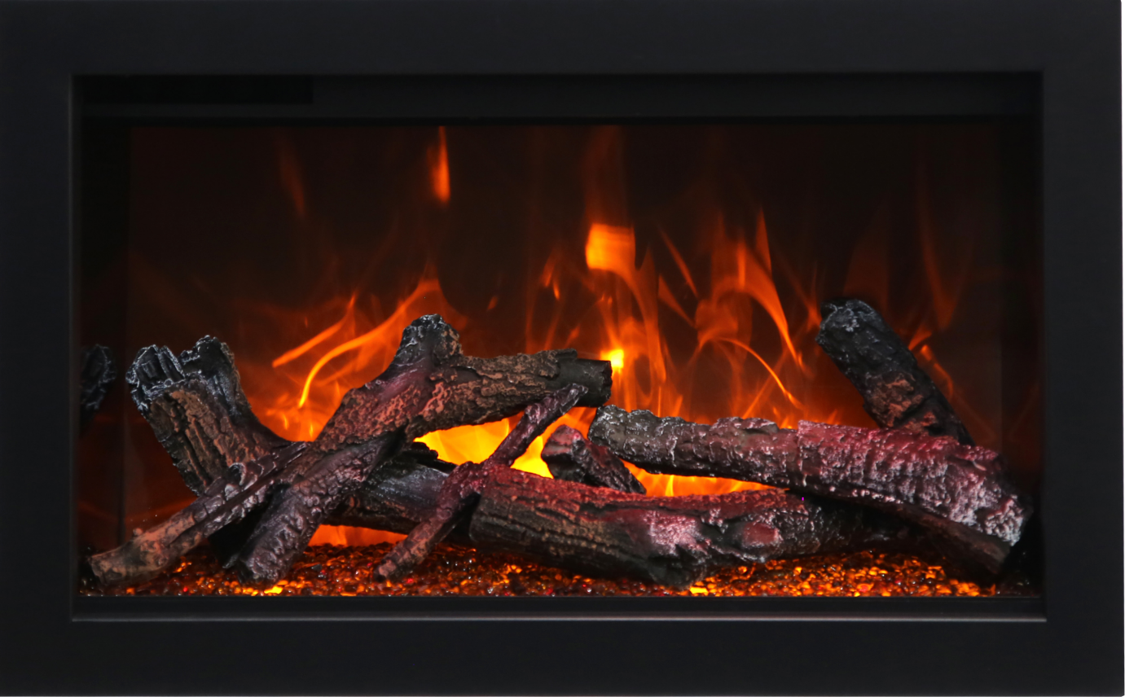
TRIMS
3-Sided and 4 Sided trims are made of 22 gauge metal and are available for the 26”, 30”, 33”, 38” size units

Slide 14
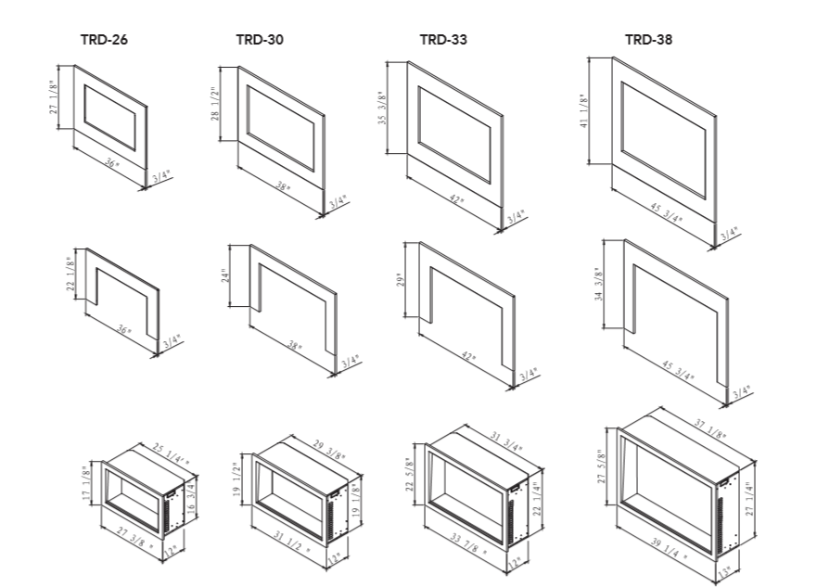

Slide 15
Tru View series
TRV SLIM
TRV XL - XT
TRV XL – DEEP
2939 XL
-

Slide 16
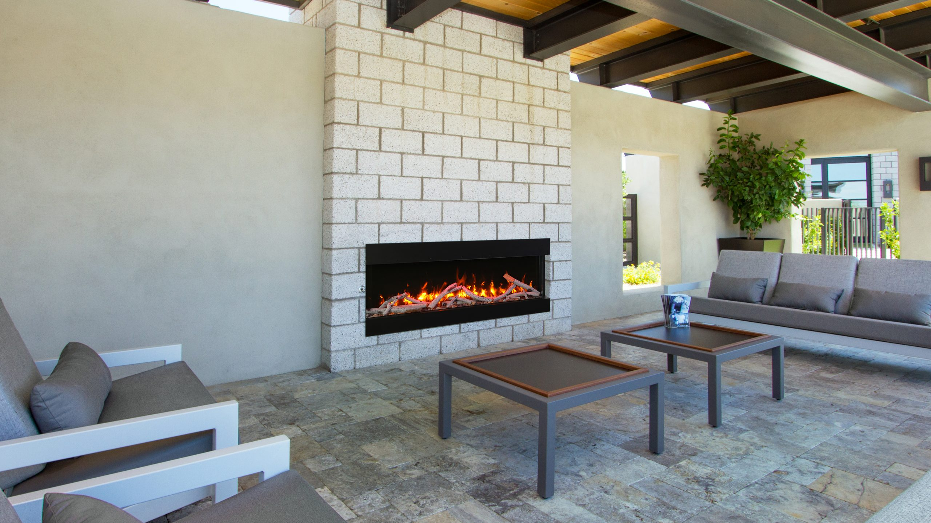
trv-slim
Very Thin – only 4” in depth
Available in sizes – 30”, 40”, 50”, 60” and 72”
Each unit comes with a 10 birch logs , charcoal grey fireglass, vermiculite, black fireglass and a remote
Thermostat hardwire ready. Electrical hard wire ready
Multi colour state of the art flame that is easily changed from blue to purple, orange and violet with just a click of the remote
2 Stage Heater. Flame operates with or without heat
Approved for Indoor and Outdoor Applications

Slide 17
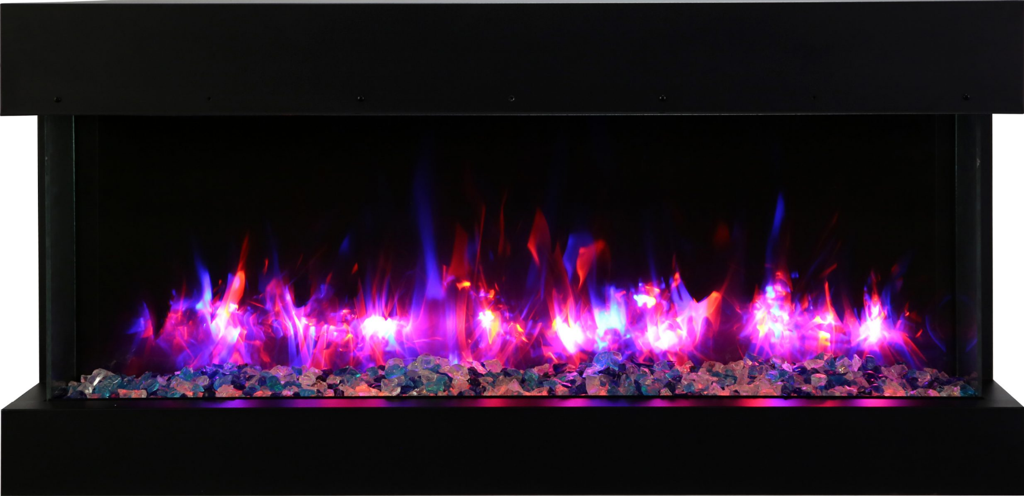
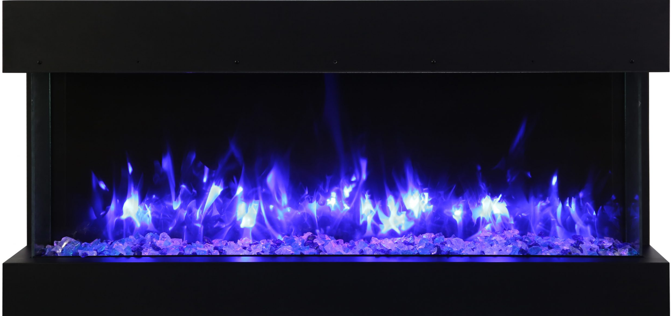
TRV-SLIM

Slide 18
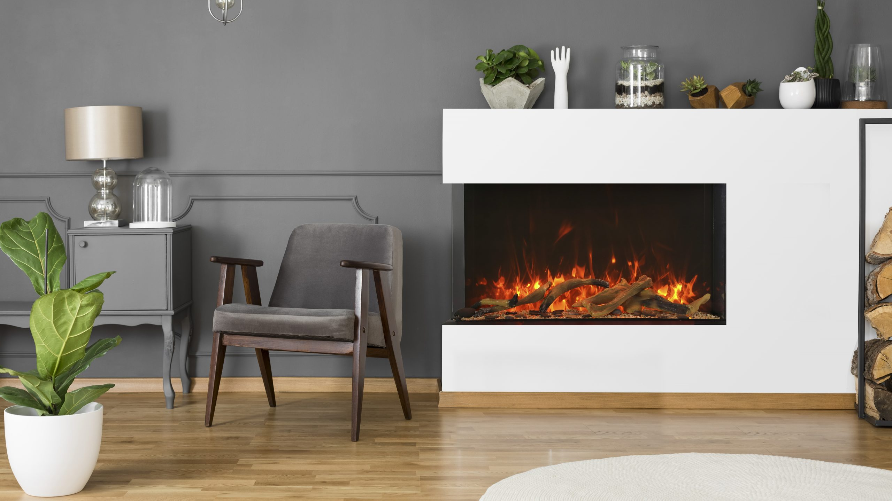
trv xl extra tall
Glass viewing area is 22” in height
Available in sizes – 40”, 50”, 60”, 72” and 88”
Each unit includes your choice of design media kit - 15 pce drift, 15 pce birch, 14 pce rustic or Ice Media
Thermostat hardwire ready. Electrical hard wire ready
Multi colour state of the art flame that is easily changed from blue to purple, orange and violet with just a click of the remote
2 Stage Heater. Flame operates with or without heat
Approved for Indoor and Outdoor Applications

Slide 19
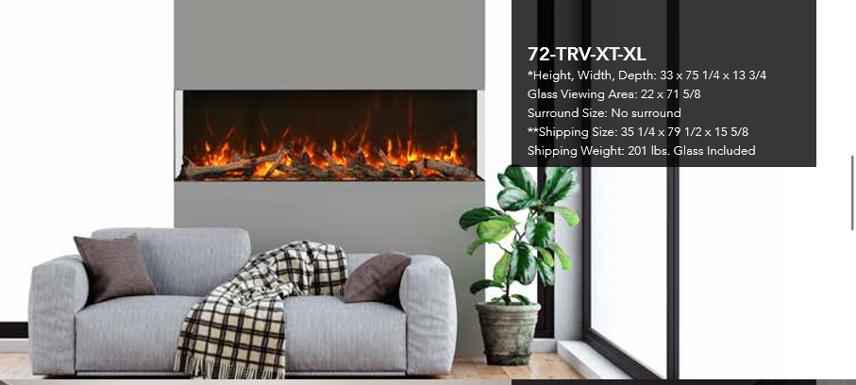
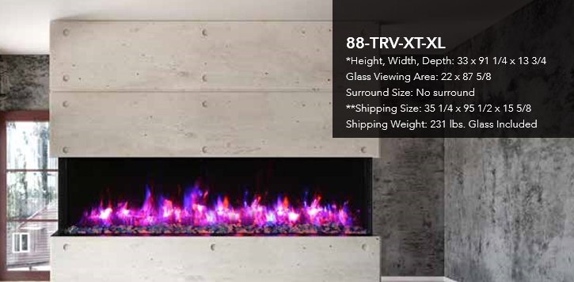

Slide 20
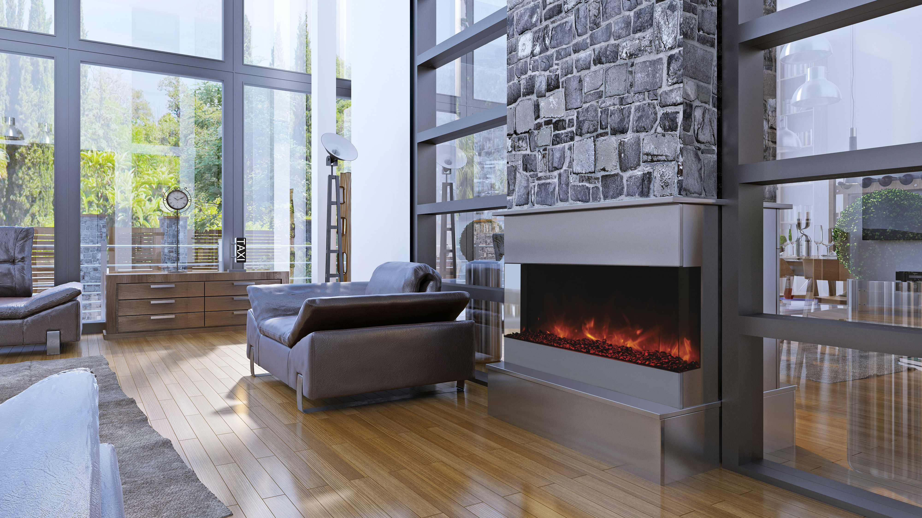
trv xl Deep
Boasting a depth of 14 ¼”
Available in sizes – 40”, 50”, 60” and 72”
Each unit includes your choice of design media kit - 15 pce drift, 15 pce birch, 14 pce rustic or Ice Media
Thermostat hardwire ready. Electrical hard wire ready
Multi colour state of the art flame that is easily changed from blue to purple, orange and violet with just a click of the remote
2 Stage Heater. Flame operates with or without heat
Approved for Indoor and Outdoor Applications

Slide 21
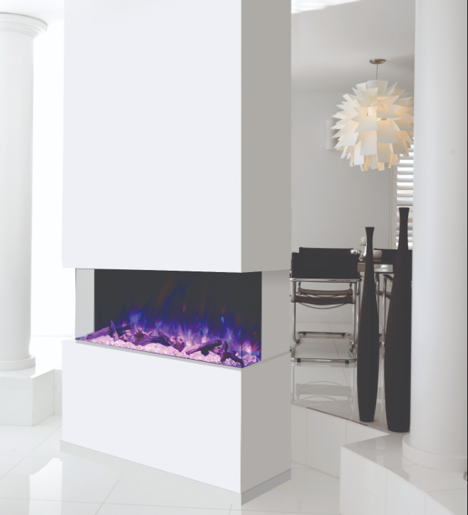
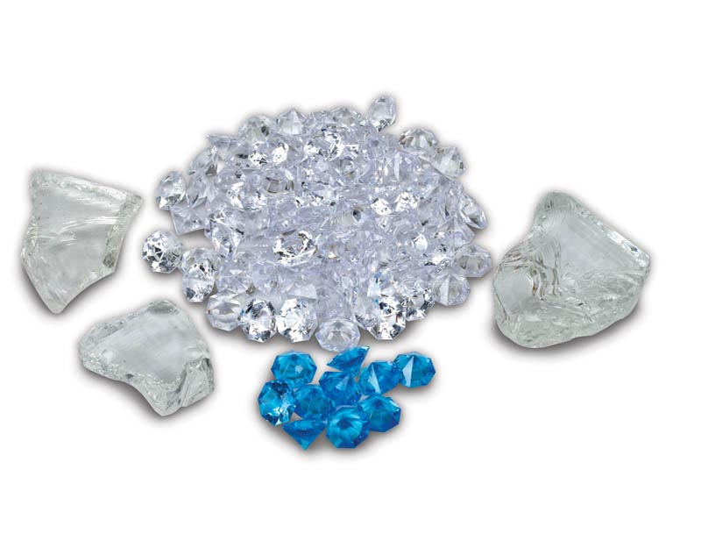

Slide 22
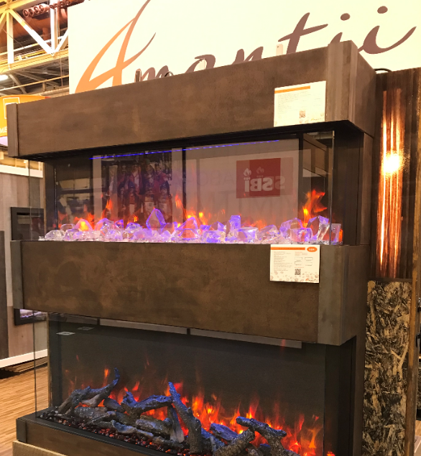
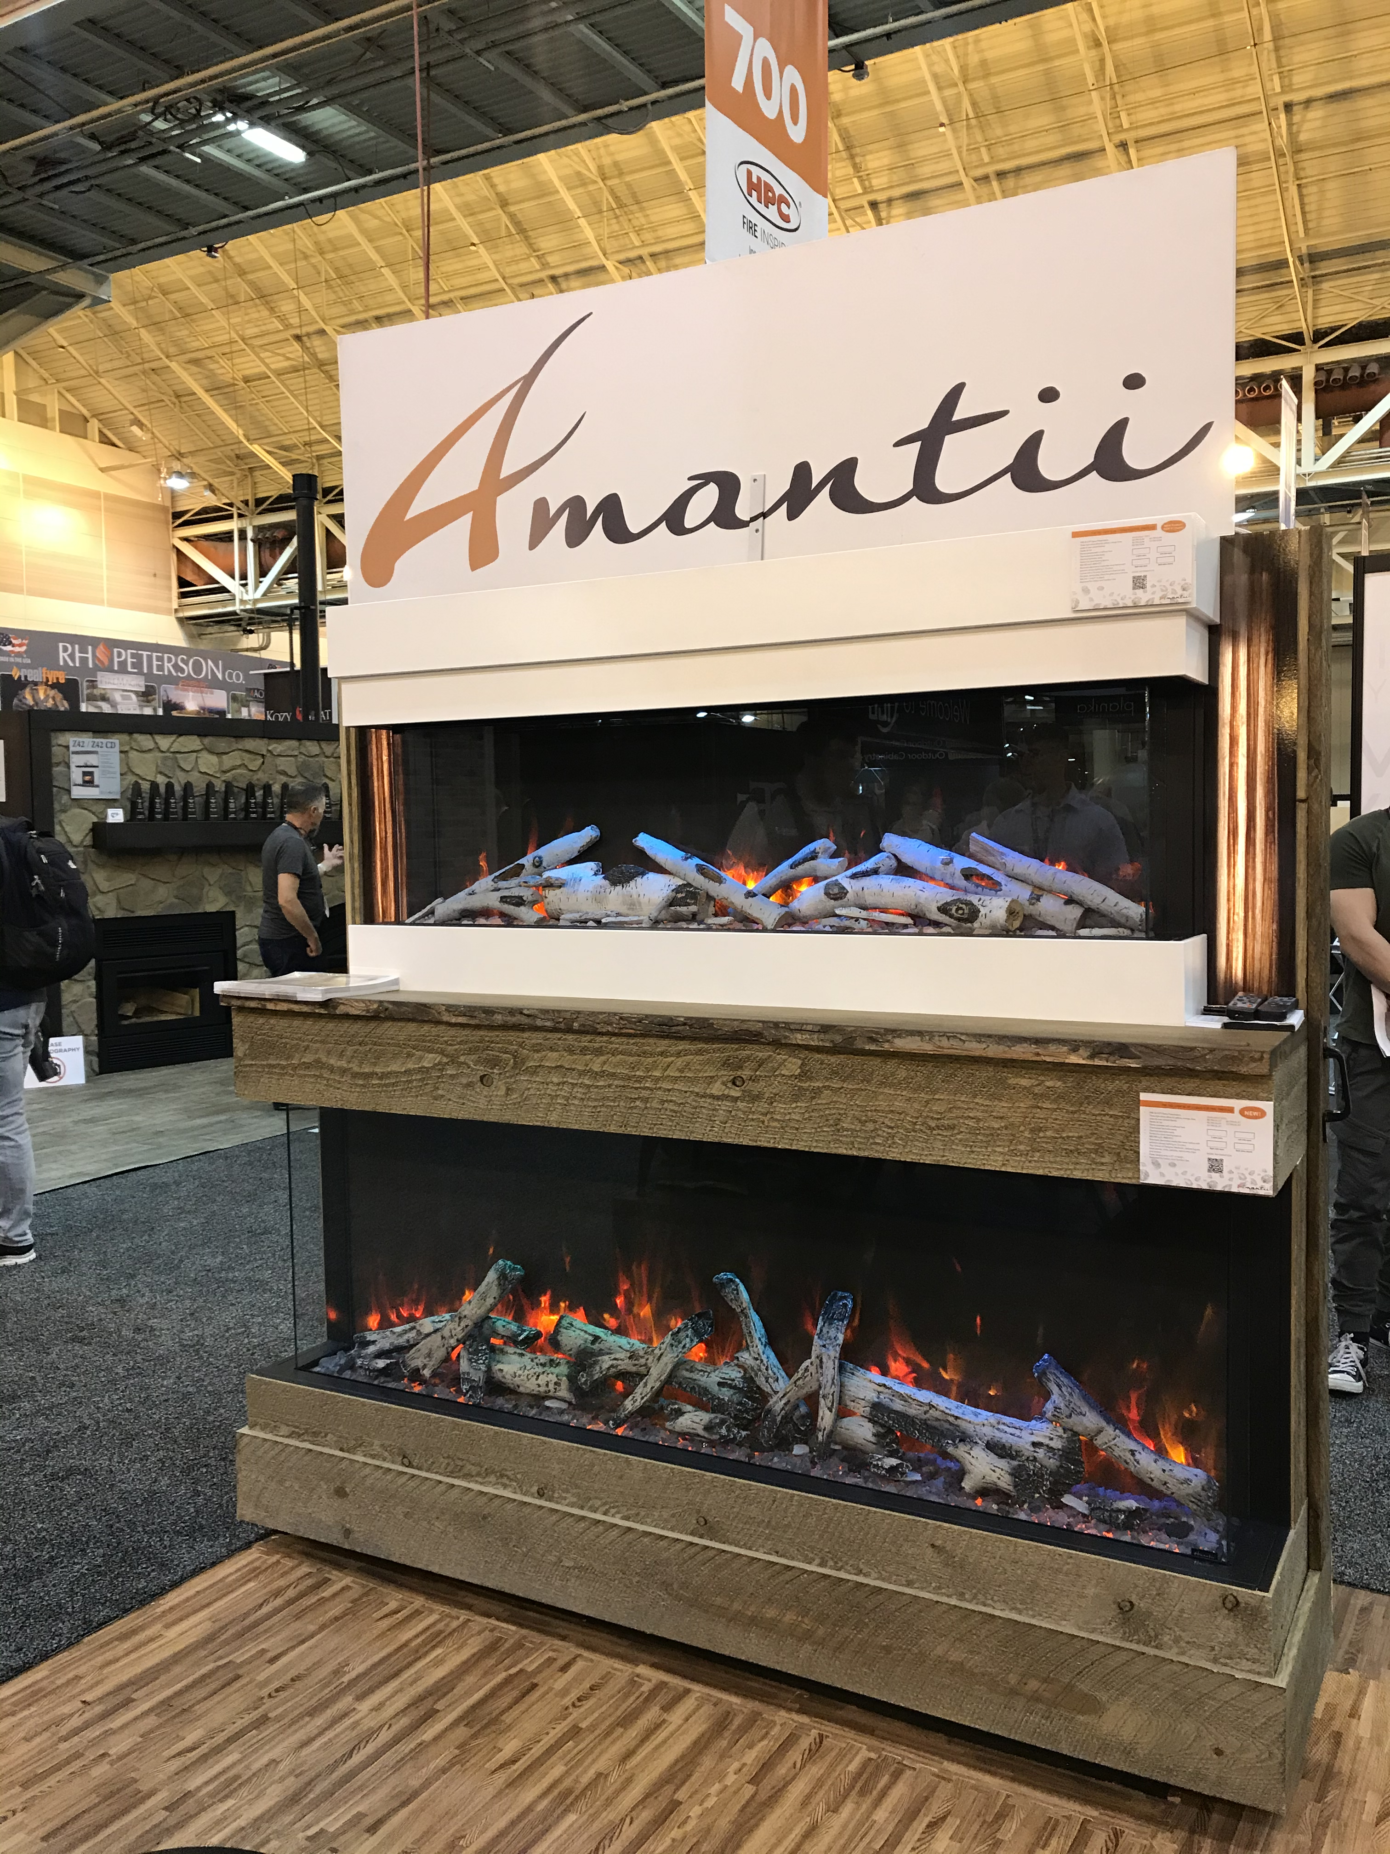

Slide 23
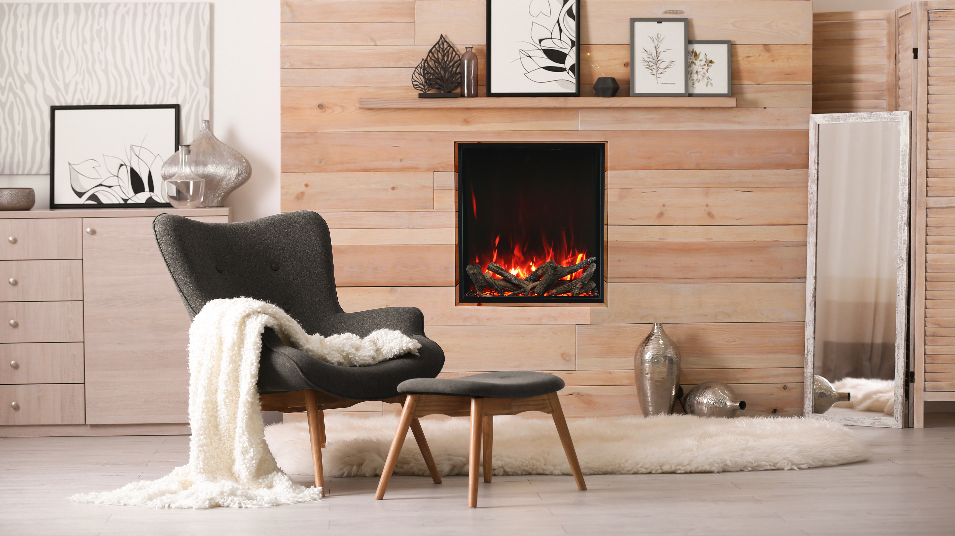
2939 XL
Each unit comes with a 10 piece birch log set
Thermostat hardwire ready. Electrical hard wire ready
Multi colour state of the art flame that is easily changed from blue to purple, orange and violet with just a click of the remote
2 Stage Heater. Flame operates with or without heat
Approved for Indoor and Outdoor Applications

Slide 24
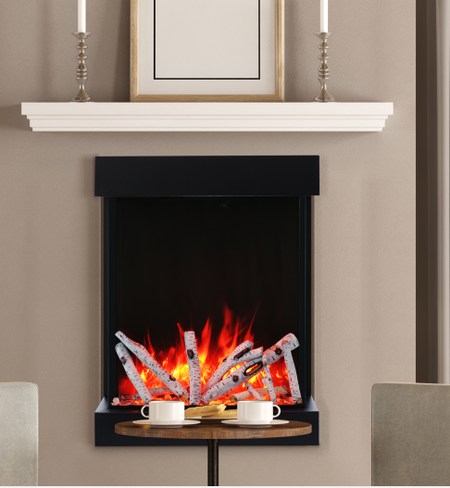
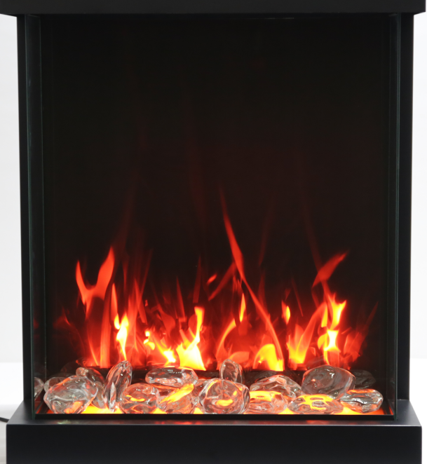

Slide 25
Symmetry series
SYMMETRY BESPOKE
SYMMETRY
SYMMETRY - B
SYMMETRY EXTRA TALL -

Slide 26
SYMMETRY BESPOKE
Among the things that make our lives more beautiful, fireplaces definitely occupy an important position. Our Symmetry Bespoke series is more than an ordinary fireplace. It is a well designed fireplace, unique, as it combines classic form in a modern interpretation.
A Few Key Features
New Concept – combining flame, quality and sound. A fireplace with sound!
Patented Thermostatic remote comes included.
Most reliable components in the industry
5 Year Warranty

Slide 29
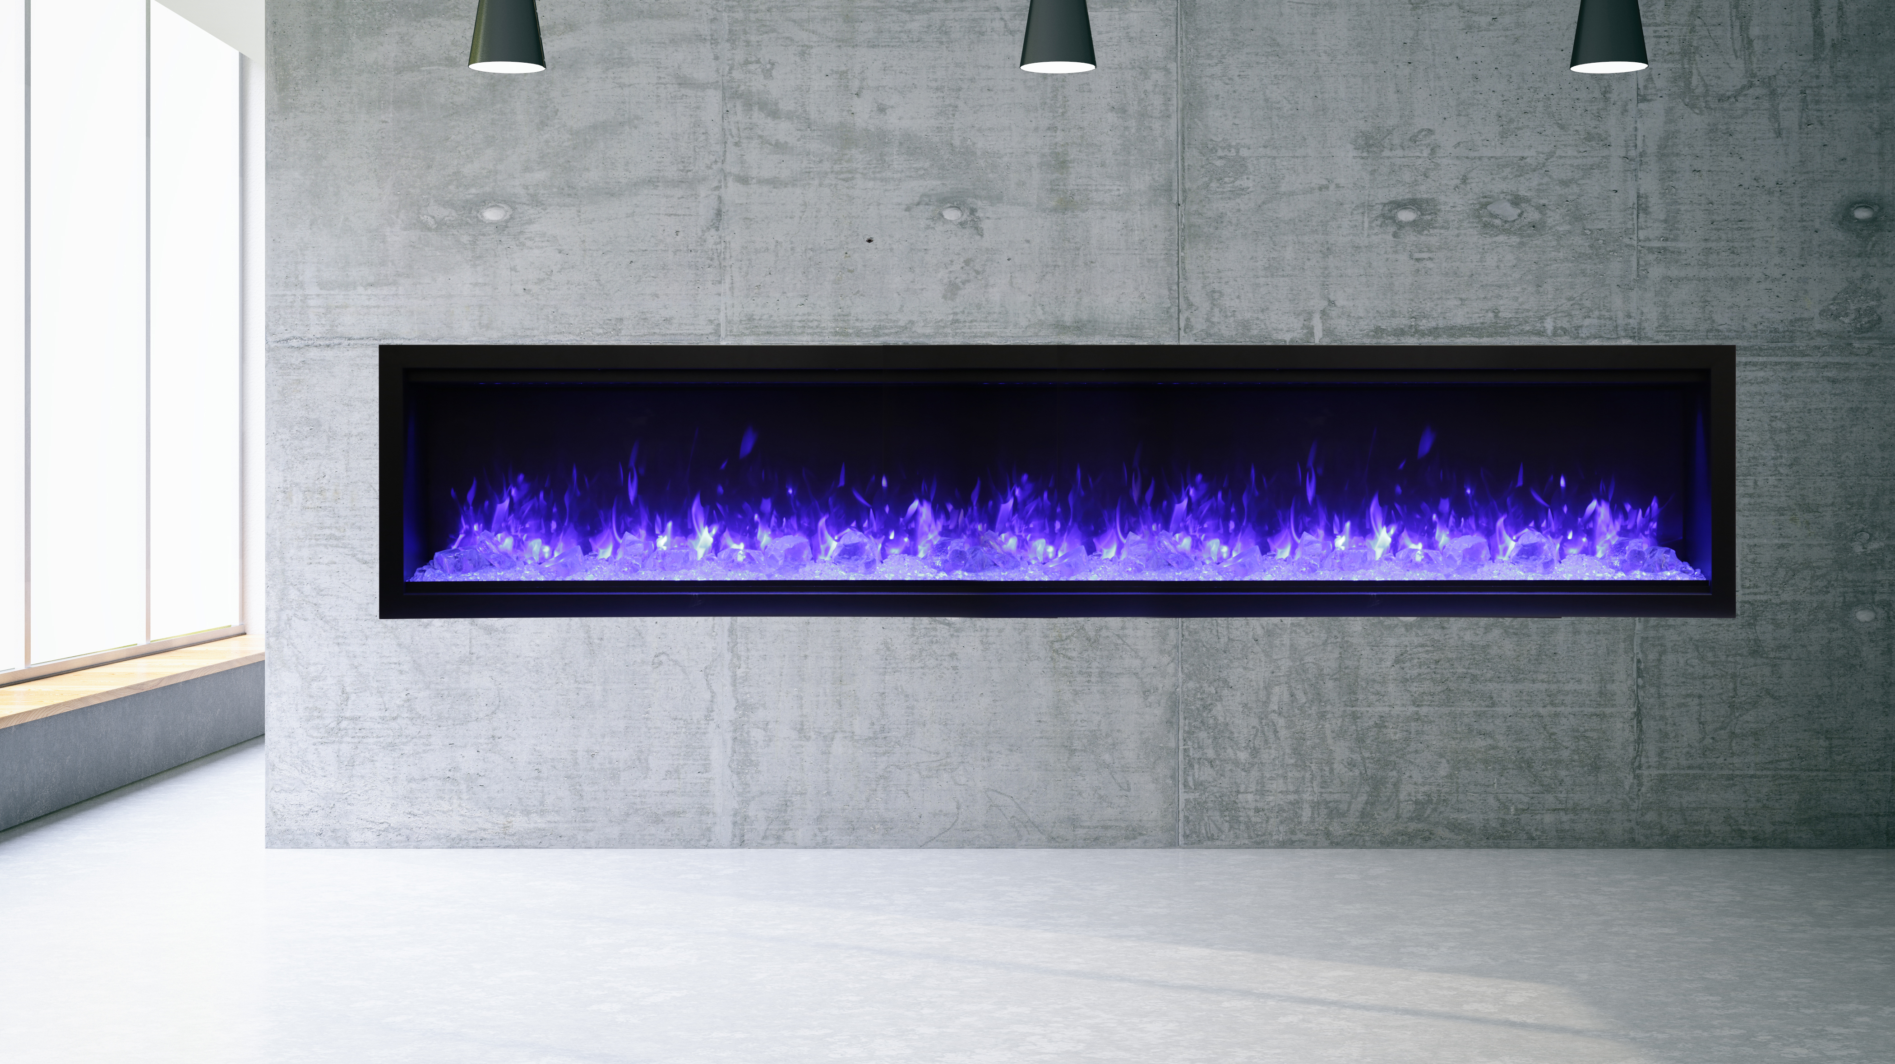
Symmetry - XT
Glass Viewing area is 18”. Our largest glass viewing area yet.
Available in sizes – 34”,42”, 50”, 60” and 74”, 88” and 100”
The Symmetry Extra Tall comes with your choice of one Designer Media Kit - Birch, Driftwood or Rustic.
The Sym 74 XT, Sym 88 XT and Sym 100 XT comes with dual heaters built in, for double the heat output.
Two flame patterns – standard diffused or more traditional – you choose!
The Sym 74 XT, Sym 88 XT and Sym 100 XT all have the option of being hooked up to 240 Volt, which increases the heat: 240V, 10A, 2400W and 8191 BTU
Touch Pad – For convenient control of features with temperature display
Approved for Indoor and Outdoor Applications

Slide 32
Symmetry - B
Sym-B is our basic model offering clean, contemporary aesthetics with no visible unsightly heat vents.
Available in sizes – 34”,42”, 50”, 60” and 74”, 88” and 100”
Standardized sizing allows for hassle free installation at any stage.
Install Option – Can be fully recessed. Can be semi flush mounted within a 2 x 4 wall. * A Sym XS Surround is required.
Ideal Applications – Commercial and Residential spaces, New Construction and renovations
Clear glass media and remote comes included
Approved for Indoor and Outdoor Applications

