Slide 1
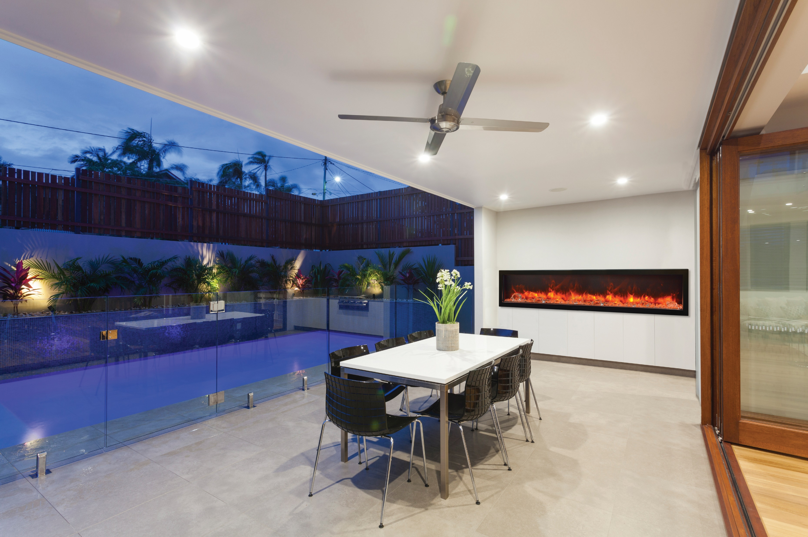

Slide 2
Designer Media kits
Design Media -6 pce
Design Media – Rustic -14 pce
Design Media – Drift -15 pce
Design Media- Birch – 15 pce
NEW! Design Media Birch 10 pce
NEW! Design Media Oak 10 pce

Slide 3
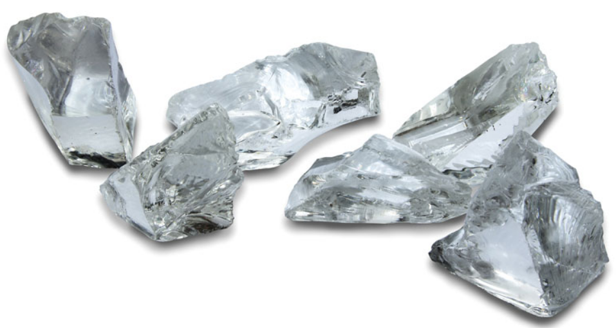
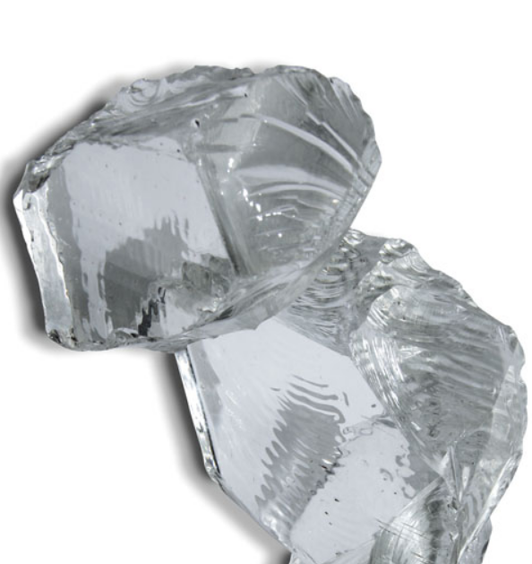
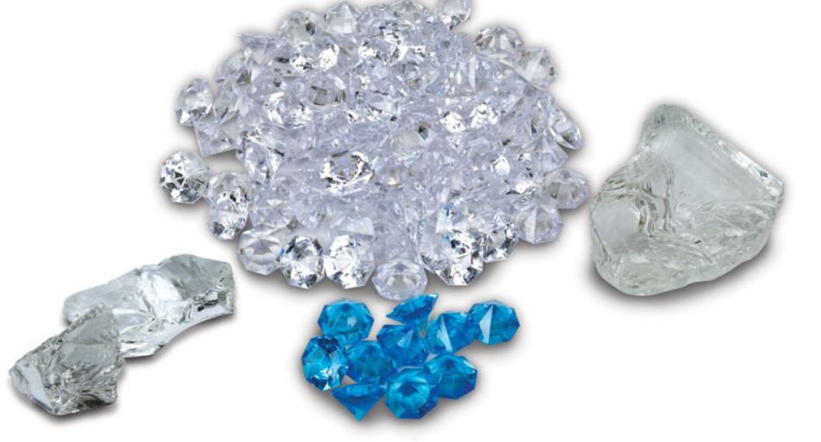
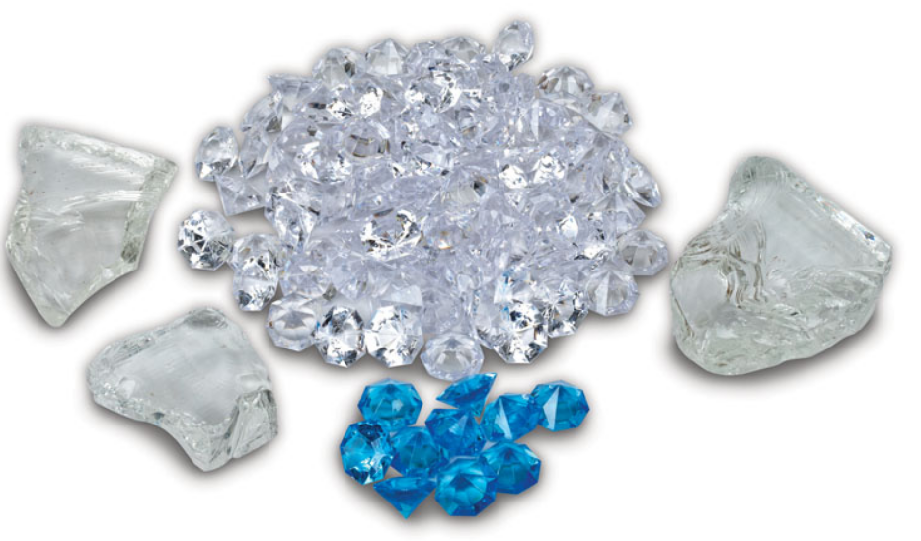

Slide 4
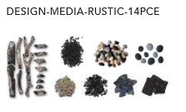
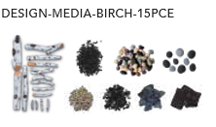
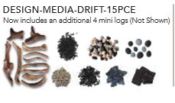
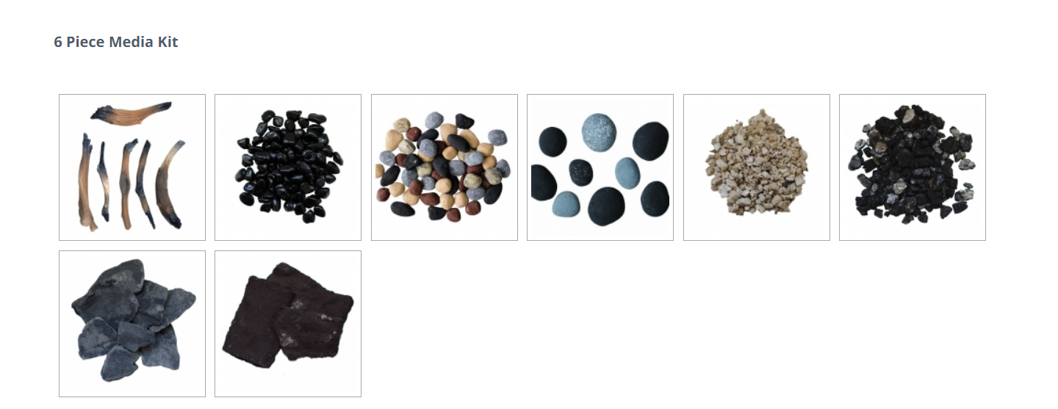

Slide 5
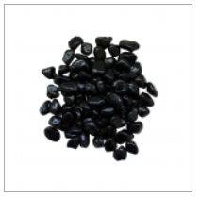
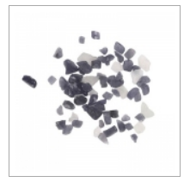
AMSF-GLASS-02 $55.00
AMSF-GLASS-05 $55.00
AMSF-GLASS-03 $55.00
AMSF-GLASS-04 $55.00
AMSF-GLASS- 08 $55.00
AMSF-GLASS-11 $55.00
AMSF-GLASS-01 $55.00
AMSF-GLASS-07 $55.00
AMSF-GLASS-13 $55.00
AMSF-GLASS- 10 $55.00
AMSF-GLASS-06 $99.00
AMSF-GLASS-09 -$55.00
Our decorative fireglass media is a beautiful addition to your fireplace. Turn your fireplace into an expressive work of art by simply adding our decorative fireglass media. Our fireglass media adds a distinctly modern feel to your fireplace – mix colour and textures for a unique appearance. Our fireglass is tempered and will not melt or degrade, some discoloration is normal on glass. .
AMSF-GLASS- 12 $55.00
AMSF-GLASS-14 $55.00

