Slide 1
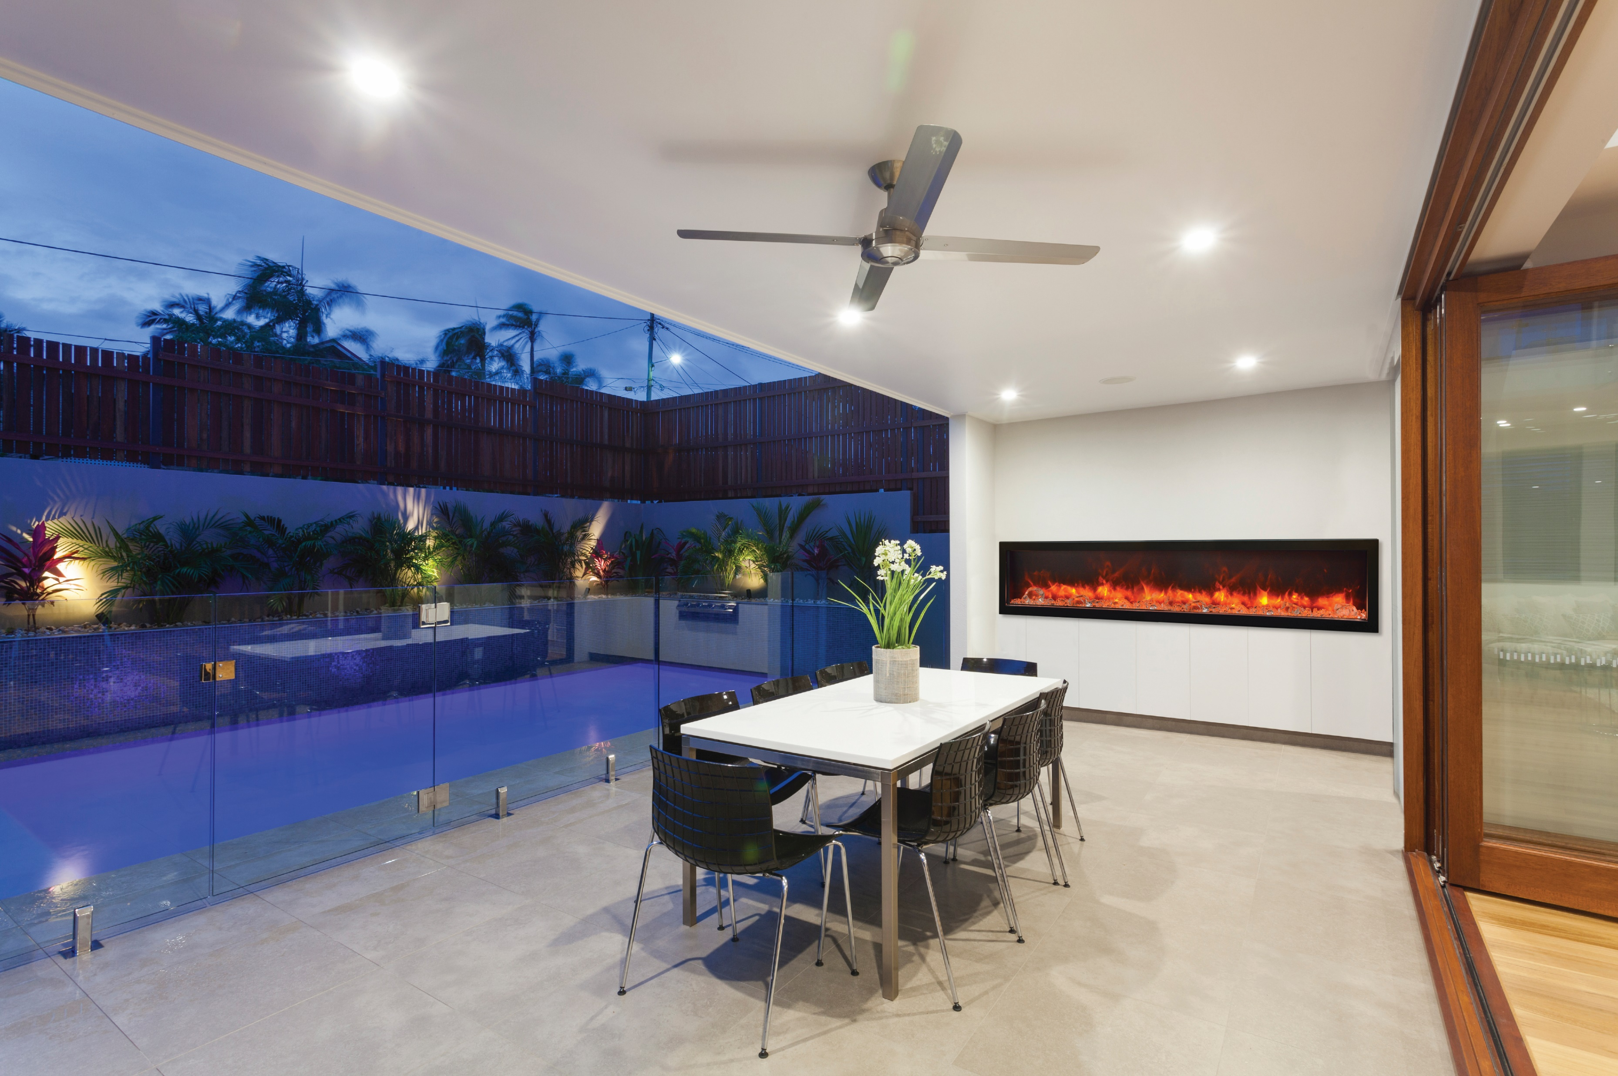

Slide 2
Symmetry series
SYMMETRY BESPOKE
SYMMETRY
SYMMETRY - B
SYMMETRY EXTRA TALL -

Slide 3
SYMMETRY BESPOKE
Among the things that make our lives more beautiful, fireplaces definitely occupy an important position. Our Symmetry Bespoke series is more than an ordinary fireplace. It is a well designed fireplace, unique, as it combines classic form in a modern interpretation.
A Few Key Features
New Concept – combining flame, quality and sound. A fireplace with sound!
Patented Thermostatic remote comes included.
Most reliable components in the industry
5 Year Warranty

Slide 6
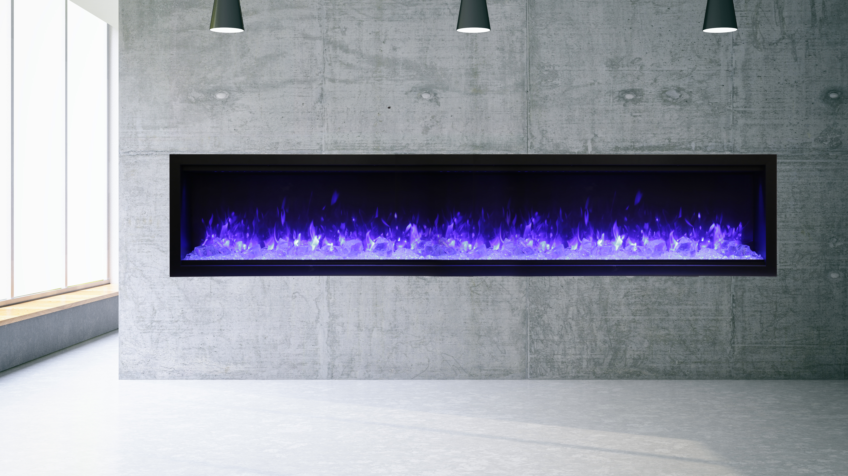
Symmetry - XT
Glass Viewing area is 18”. Our largest glass viewing area yet.
Available in sizes – 34”,42”, 50”, 60” and 74”, 88” and 100”
The Symmetry Extra Tall comes with your choice of one Designer Media Kit - Birch, Driftwood or Rustic.
The Sym 74 XT, Sym 88 XT and Sym 100 XT comes with dual heaters built in, for double the heat output.
Two flame patterns – standard diffused or more traditional – you choose!
The Sym 74 XT, Sym 88 XT and Sym 100 XT all have the option of being hooked up to 240 Volt, which increases the heat: 240V, 10A, 2400W and 8191 BTU
Touch Pad – For convenient control of features with temperature display
Approved for Indoor and Outdoor Applications

Slide 7
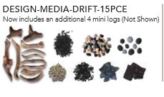
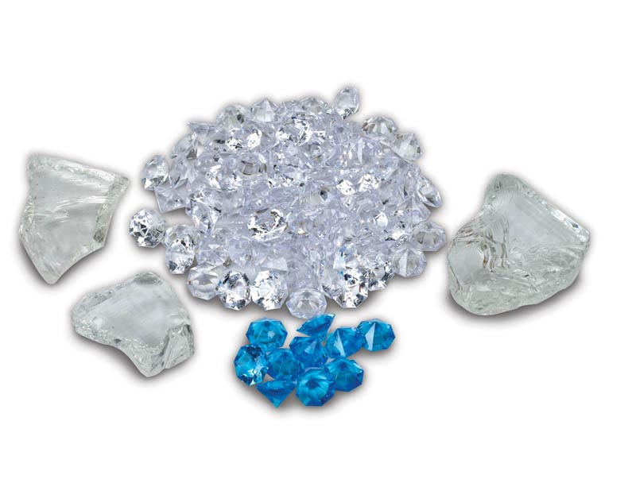
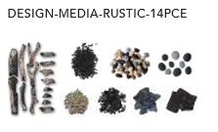
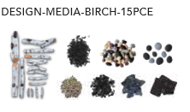

Slide 9
Symmetry - B
Sym-B is our basic model offering clean, contemporary aesthetics with no visible unsightly heat vents.
Available in sizes – 34”,42”, 50”, 60” and 74”, 88” and 100”
Standardized sizing allows for hassle free installation at any stage.
Install Option – Can be fully recessed. Can be semi flush mounted within a 2 x 4 wall. * A Sym XS Surround is required.
Ideal Applications – Commercial and Residential spaces, New Construction and renovations
Clear glass media and remote comes included
Approved for Indoor and Outdoor Applications

