Slide 1

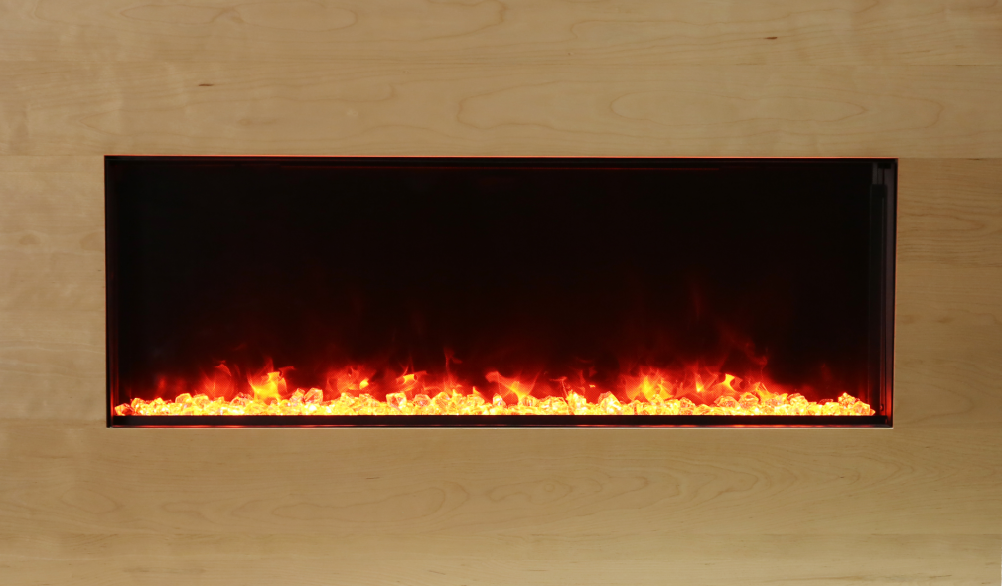
SURROUND INSTALLATION GUIDE
BI-40-XTRASLIM Series

Slide 2

IMPORTANT SAFETY INSTRUCTIONS
!
If the information in these instructions are not followed exactly, a fire or explosion may result causing property damage, personal injury or loss of life.
Read all instructions before installing or using this fireplace.
Keep combustible materials, such as furniture, pillows, bedding, papers, clothes and curtains at least 3 feet from the front, sides and rear of the fireplace.
Always unplug heater when not in use.
Do not operate the fireplace if it has a damaged cord or plug, after it has malfunctioned, or if the unit has been dropped or damaged in any way.
Do not use the fireplace outdoors.
Do not run the cord under carpeting. Do not cover the cord with throw rugs, runners or anything else. Arrange the cord away from traffic areas where it could not be tripped over.
To disconnect the fireplace, turn the controls to "OFF" before removing the plug from the outlet.
Do not insert or allow foreign objects to enter any ventilation or exhaust opening as this may cause an electric shock or fire, or damage to the fireplace.
To prevent a possible fire, do not block air intakes in any manner.
A fireplace has hot and arcing or sparking parts inside. Do not use it in areas where gasoline, paint or flammable liquids are used or stored.
Use this heater only as described in this manual. Any other use not recommended by the manufacturer may cause fire, electric shock, injury and will void the warranty.
Avoid the use of an extension cord, the extension cord will overheat and cause a fire. This fireplace is not to be used with an extension cord.
Always use properly grounded fused and polarized outlets.
Always use ground fault protection where it is required by electrical codes.
Always disconnect the power before performing any cleaning, maintenance or relocation of the fireplace.
To prevent a possible fire, do not burn wood or other materials in this fireplace.
To prevent electric shock or fire, always use a certified electrician, should new circuits or outlets be required.
When transporting or storing the heater, keep it in a dry place, free from excessive vibration.
This fireplace should not be modified under any circumstances.
Packaging material should be kept away from children and be disposed of in a safe manner. Plastic bags are not toys and should be kept away from children and infants.
Do not use this fireplace in small rooms occupied by persons not capable of leaving the room on their own, unless constant supervision is provided.
If the glass is damaged, do not use the heater in order to avoid a hazard.
Do not leave children unsupervised where fireplace is turned on.
CAUTION Some parts of this product can become very hot and cause burns. Particular attention has to be given where children and vulnerable people are present.
This fireplace can be used by children aged from 8 years and above and persons with reduced physical, sensory or mental capabilities or lack of experience and knowledge if they have been given supervision or instruction concerning use of the appliance in a safe way and understand the hazards involved. Children shall not play with the appliance. Cleaning and user maintenance shall not be made by children without supervision.
NOTE: Although the fireplace is rated for outdoor use, the surround is for indoor use only.

Slide 3
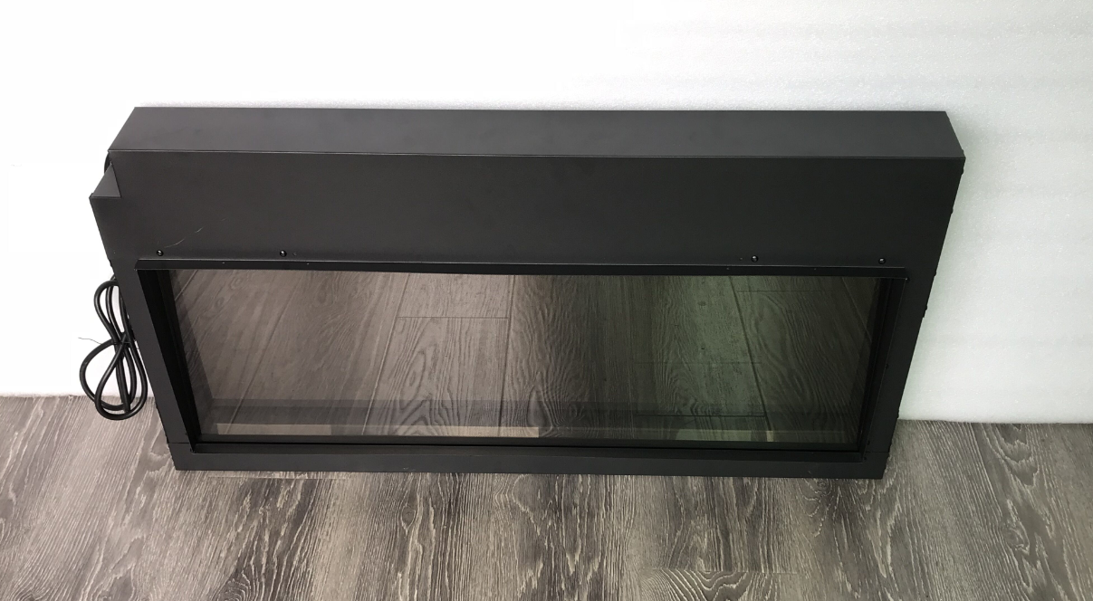
{
}
STEP 1:
Carefully remove the fireplace from the box.
Prior to installing the fireplace, test to make sure it operates properly by
plugging the power supply cord into a 120 Volt grounded outlet.
Test all aspects of its operation (manual switches, remote and heater) to make sure all components are operating correctly.
As with most electronic devices, your new electric fireplace has been designed to operate at temperatures between 5 ℃ (41℉) and 35 ℃ (95℉). During the cold winter months, allow the fireplace to reach room temperature before turning it on.
NOTE: There may be trace of odor during the first few minutes of initial use. This is harmless, normal and will not occur again.

Slide 4
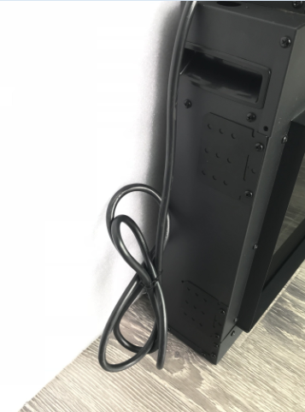
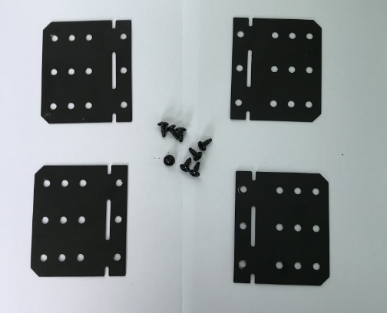
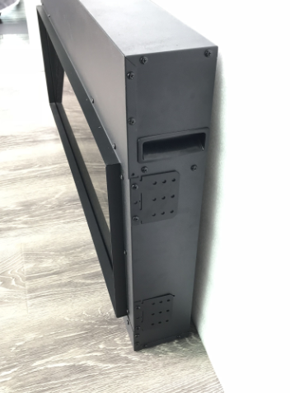
STEP 2:
Carefully remove the screws and framing plates from the sides of your fireplace.
Store with manual and warranty , these framing plates will not be used with the surround.

Slide 5
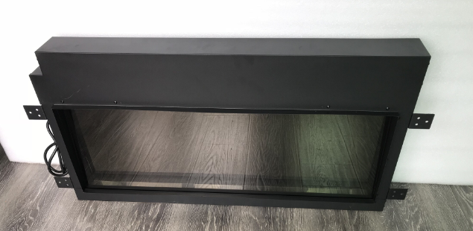
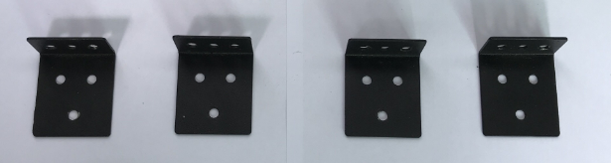
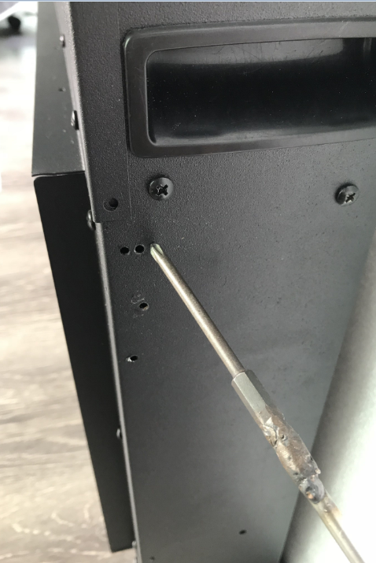
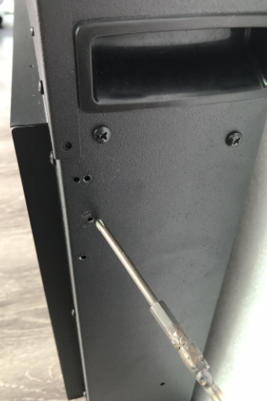
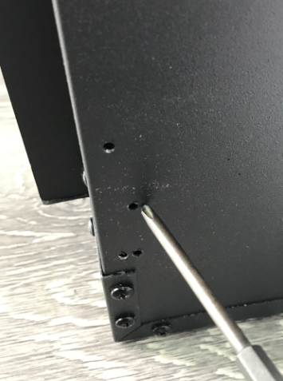
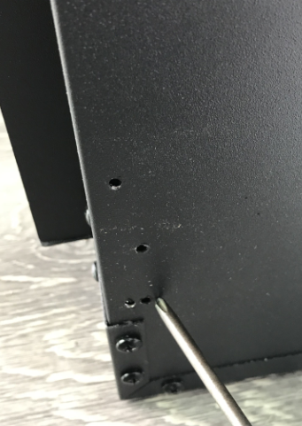
STEP 3:
Using the provided screws secure the mantel brackets to the sides of the fireplace in place of the framing plates.
When securing the surround brackets, ensure that you are inserting the screws into the proper pilot holes. Shown in diagram below.
If you do not attach the screws in the correct pilot holes, the surround will not properly attach to the fireplace.

Slide 6
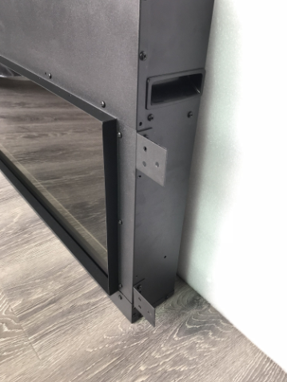
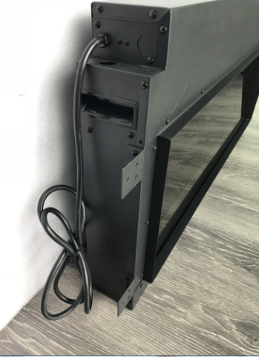
!
STOP AND CHECK
When you completed step 1 through step 3, your fireplace should look like the pictures shown with the surround plates attached.
Please ensure your plates are flush with the trim and securely screwed into the pilot holes. If they are not as shown, remove the screws and repeat step 3.

Slide 7
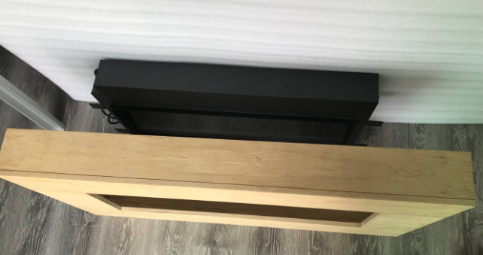
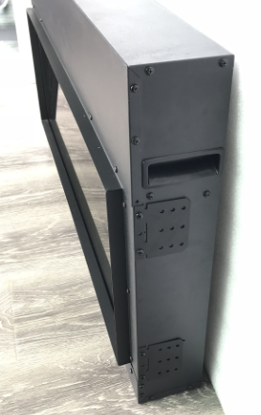
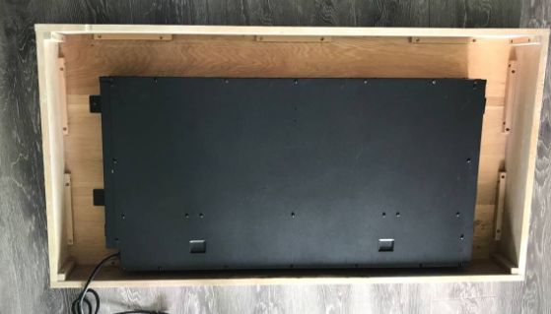
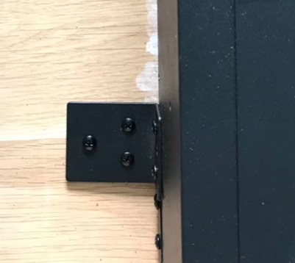
STEP 4:
Insert the fireplace into the opening of the surround ensuring the flange (circled above) fits into the opening.
STEP 5:
Secure the fireplace to the surround using the attached surround brackets and screws.

Slide 8
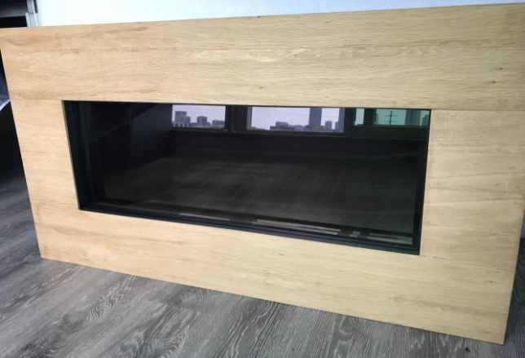
You have now successfully mounted your fireplace onto the wood surround.
Next we will mount the fireplace to the wall.
Disclaimer: Amantii’s newest line of birch wood surrounds bring the beauty of genuine wood into your home or business. Each of these surrounds have been crafted from birch wood and a paint wash applied, reflecting the variety of colors found in a birch tree forest.
As with all genuine products, variations to the natural wood grain will mean there will be slight variations that may differ from the catalog images or samples.
A touch up pen has been included in the packaging should there be any imperfections caused by the shipping of this product.

Slide 9
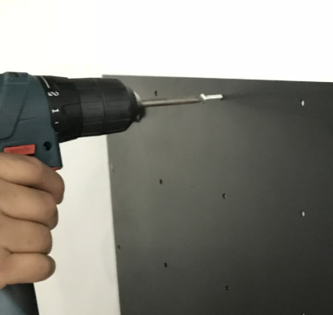
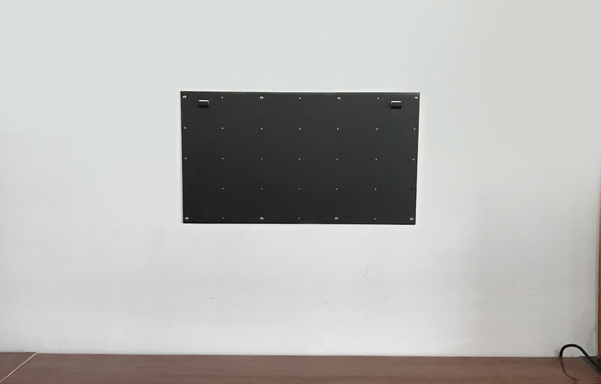
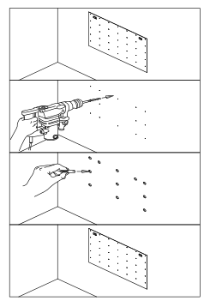
WARNING: Be sure that the bolts have been properly anchored to withstand the weight.
!
NOTE:
Due to the many different materials used to build walls, it is highly recommended that you consult your local builder before you install this fireplace on a wall.
1. Select a location that is not prone to
moisture and is locates at least 0.91
m or 3 feet away from combustible
materials such as curtains or drapes,
furniture, bedding, paper, etc.
2. Using a spirit level select a position in which to mount the fireplace horizontally.
As it appears in your manual:
4. Remove the hanger from the fireplace by removing the screws.
See image above.
3. Check the wall to ensure there is no
wiring, pipe wires etc. in the area to be
drilled. Drill 8 or more pilot holes
depending on the size of the unit
purchased, (8mm diameter & 40mm
depth) using a suitable size drill bit
and insert the wall plugs into the pilot
holes.
5. Fasten the hanger to the wall.
See image above.

Slide 10
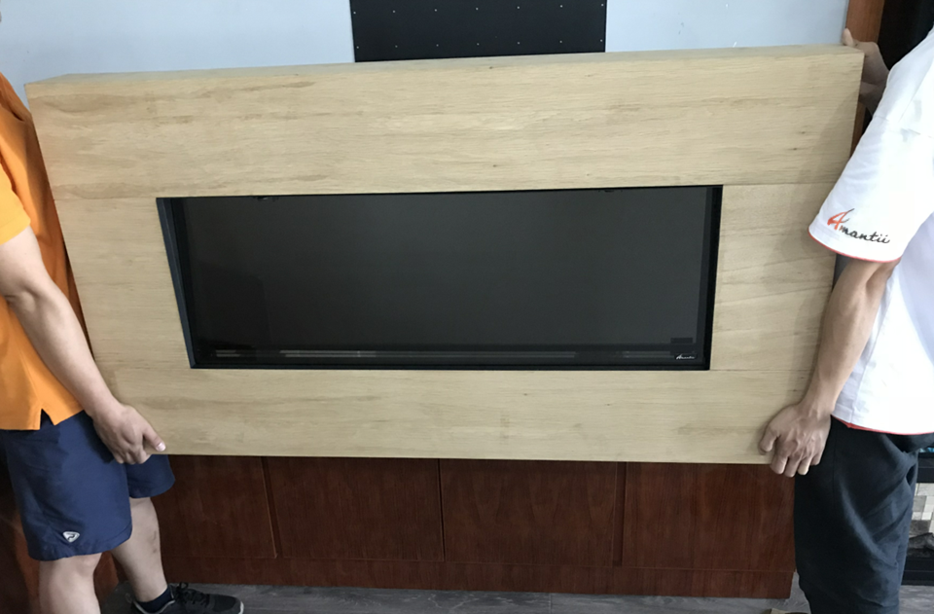
HEAVY:
!
The unit is heavy, make sure 2 people handle the whole set and operate with care.

Slide 11
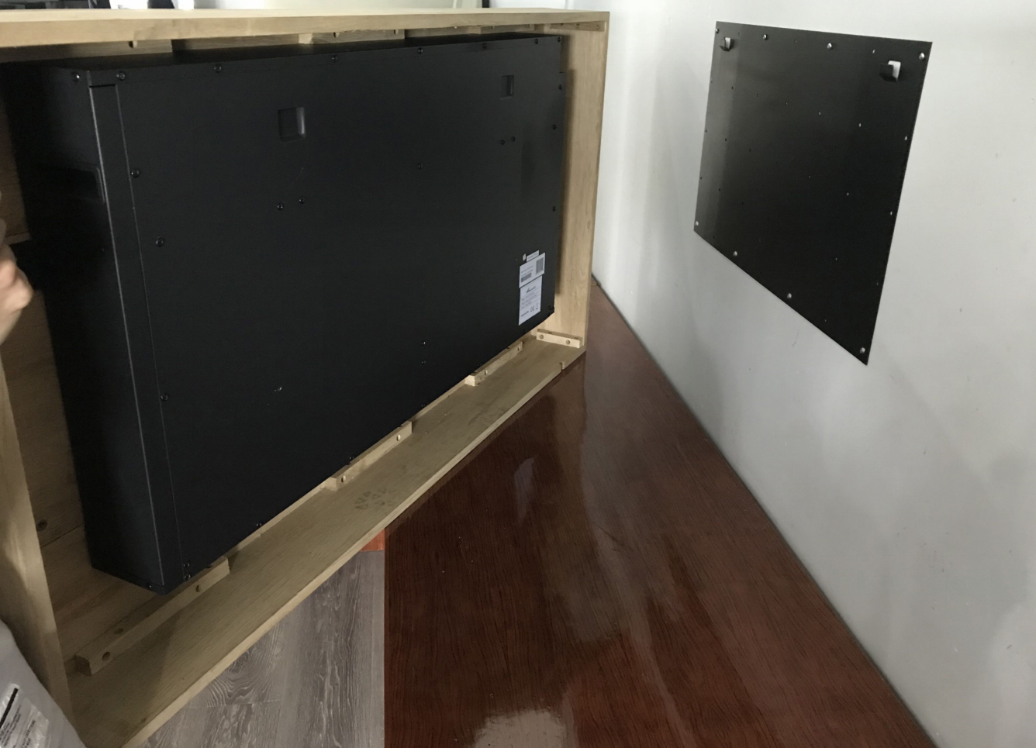
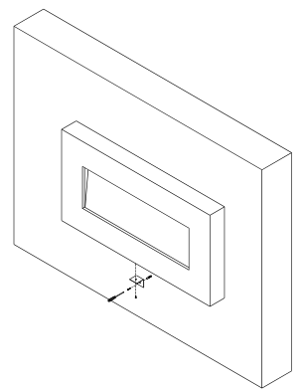
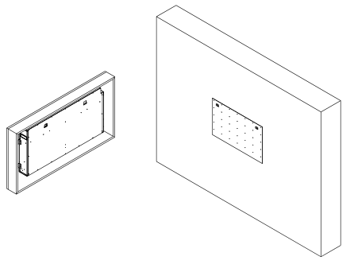
As it appears in your manual:
6. Secure the fireplace to the hanger mounted on the wall.
7. To prevent fireplace from moving, use the provided safety bracket to fasten the fireplace to the wall.

Slide 12
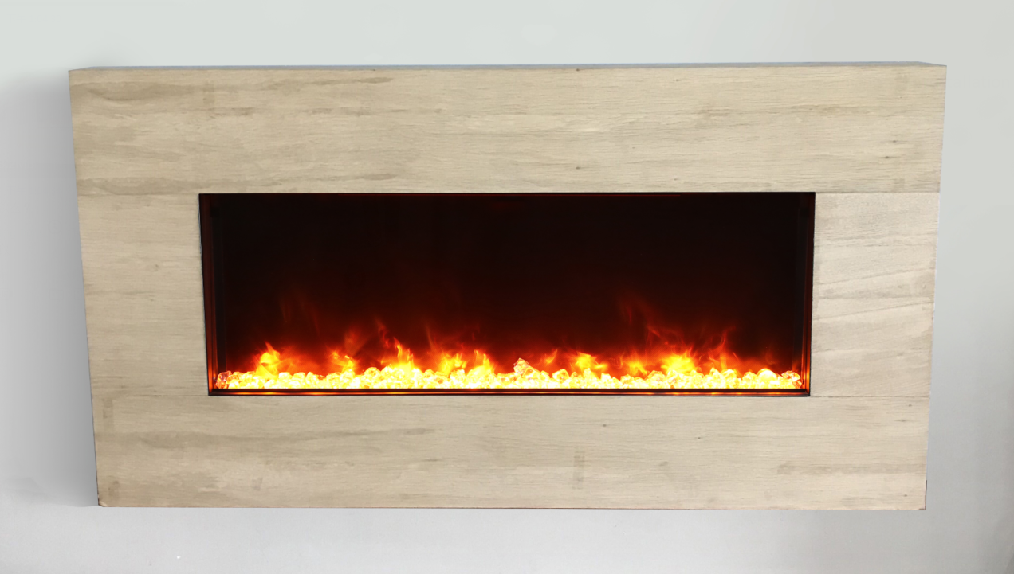

You have successfully completed the installation.
Enjoy your Amantii products!
For complete instruction guide and more info:

